Slide 1
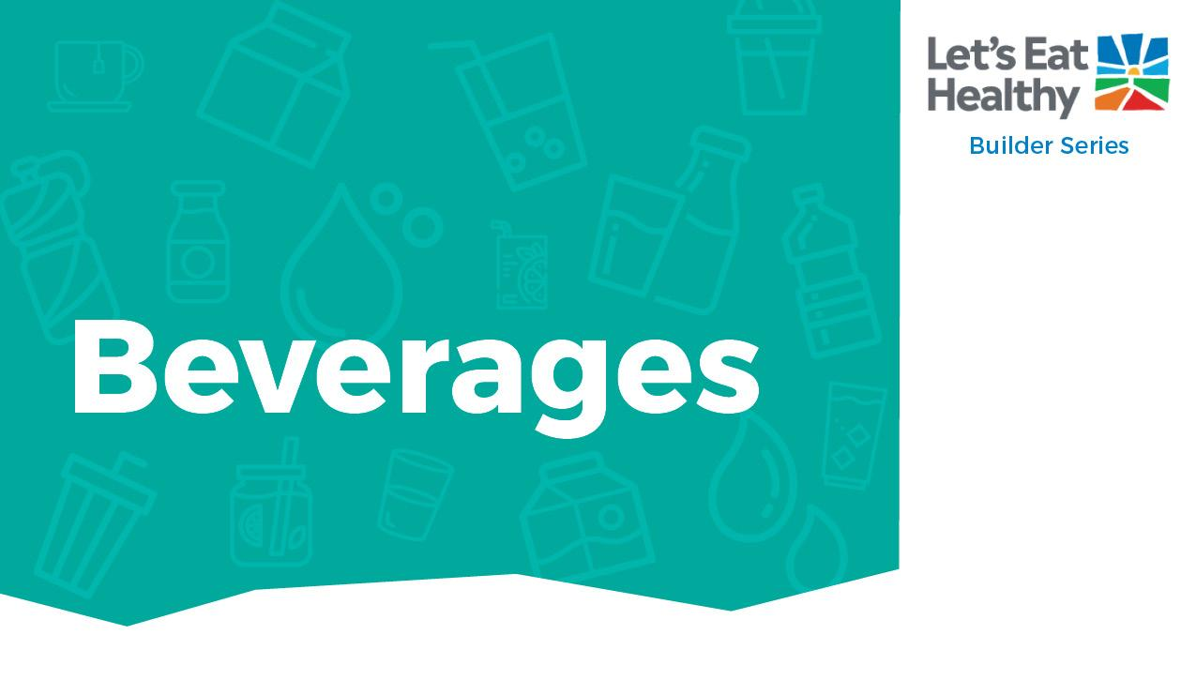

Educator Guide

Slide 2

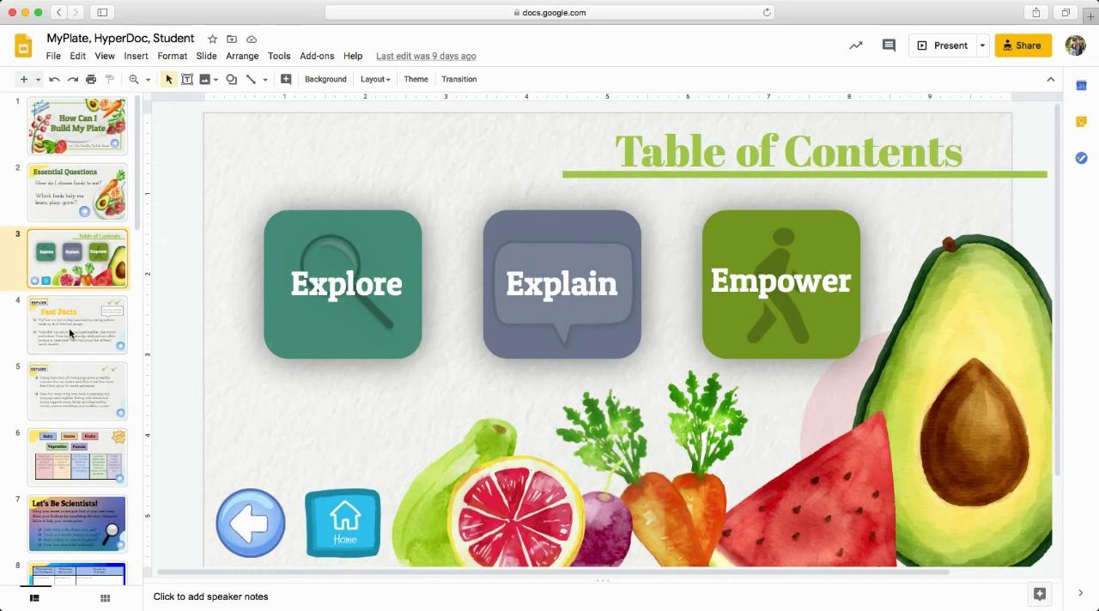

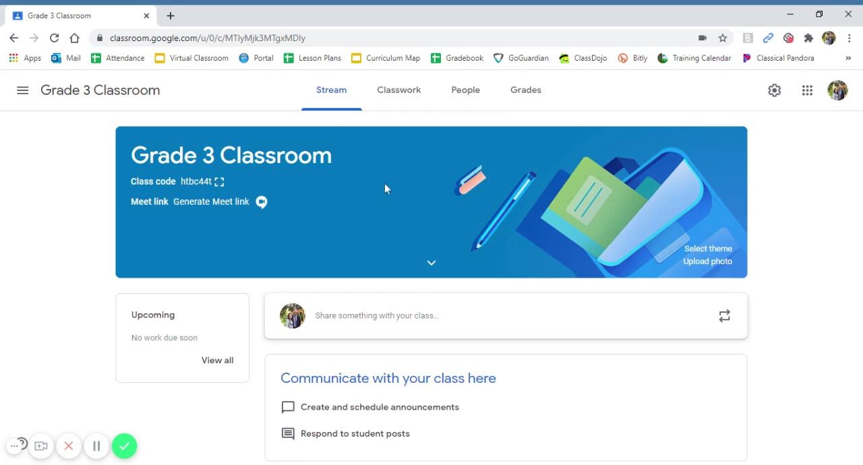


Navigating Digital Google Slides
Using HyperDoc:
You are using the Educator Guide, which includes notes and instructional videos.
Watch these 2 videos as an introduction to using the Builder Series.
The Builder Series is an interactive HyperDoc that includes aligned standards, facts, and slides labeled “Educator Guide” that are hidden from student view when presenting this material.
To make hidden slides viewable, simply select the slides, right click, and deselect Skip Slide.
Adding HyperDoc to Google Classroom:

Slide 3
Section | Supported Standards CCSS-ELA | Rationale | RFM* CCSS – ELA | Supported Standards Health | Rationale | Supported standards PE | Rationale
Explore | CCSS.ELA-LITERACY.RI.3.1 | Ask and answer questions to demonstrate understanding of a text, referring explicitly to the text as the basis for the answers. | Work with students to complete the image sort and discovery table to connect the text to their lives.
Explain | CCSS.ELA-LITERACY.RI.3.1 | Use information gained from illustrations (e.g., maps, photographs) and the words in a text to demonstrate understanding of the text | Help students match images to nutrition facts to help them understand why some drinks are better choices for them than others. | 5.1.G | Examine why a variety of behaviors promote healthy growth and development.
Empower | CCSS.ELA-LITERACY.RI.3.1 | Use information gained from illustrations (e.g., maps, photographs) and the words in a text to demonstrate understanding of the text | Look at pictures of kids and help students label and identify what fits best. This will help them make good drink choices | 6.1.P | Set a short-term goal for positive health practices
Physical Activity |  |  |  | Grade 4: 1.3.N, 1.6.N, 5.1.N, 5.2.N, 7.1.N, 7.2.N, 7.4.N Grade 5: 1.3.N, 1.6.N, 1.8.N, 5.1.N, 5.2.N, 7.1.N |  | Grade 3: 3.3, 3.7, 4.5 Grade 4: 3.3, 3.7, 4.5 Grade 5: 3.3, 3.7, 4.2

Slide 4
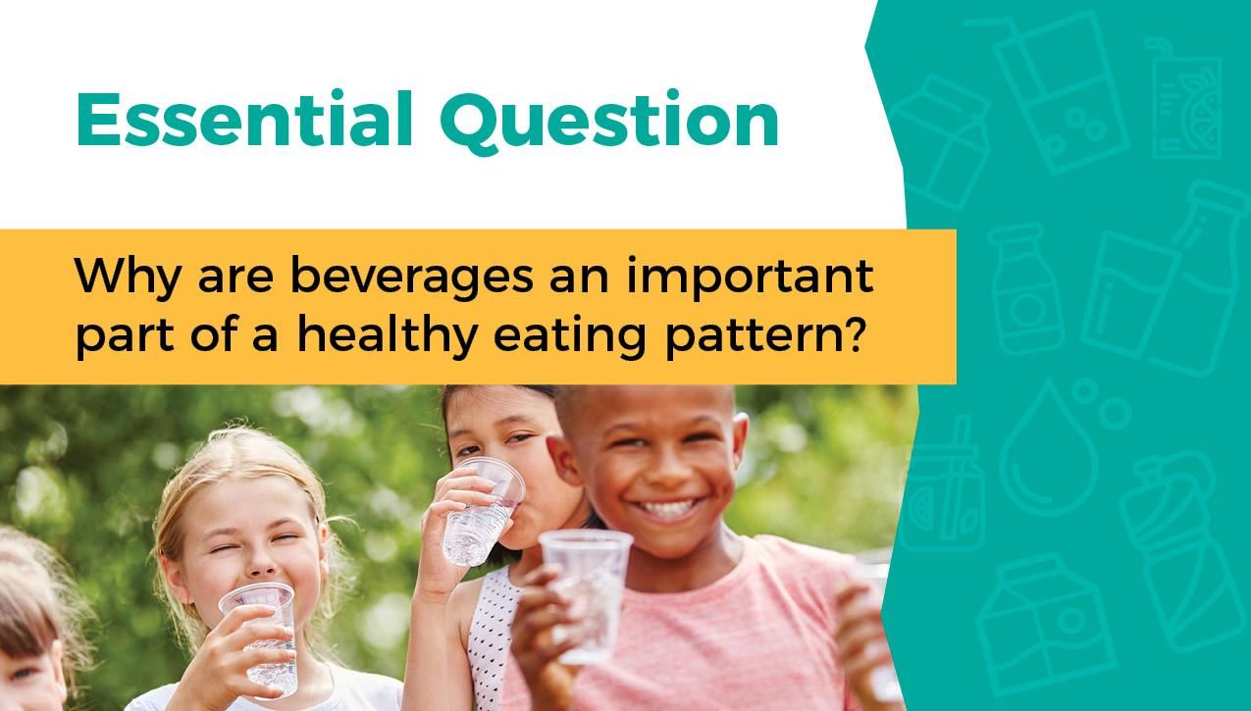

Slide 5
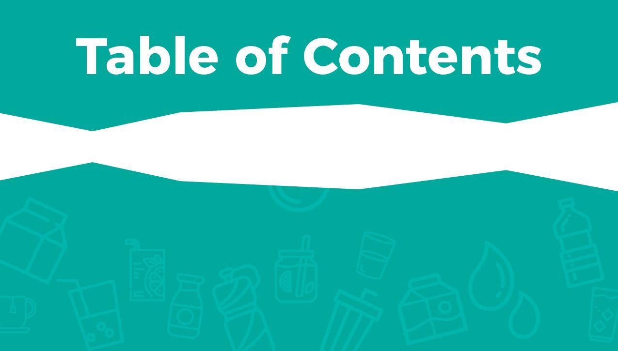





Slide 6

Water is important for overall hydration. It helps cool our bodies, digest food, maintain joints, protect our bodies, and helps remove wastes through sweating and other body secretions.
Kids can become easily dehydrated and they may not recognize signs of thirst. Signs of dehydration are: tiredness, dry mouth and lips, dizziness and headaches.
Milk is great for growing children. It is a nutrient-rich and affordable source of many key nutrients like calcium, protein, and vitamins A and D. Low-fat or fat-free dairy foods every day is recommended by the Dietary Guidelines for Americans.
Health Professionals recommend limiting beverages with added sugar like fruit-flavored punches, soft drinks, sports drinks and energy drinks. These drinks provide calories but little or no nutritional value.

Slide 7
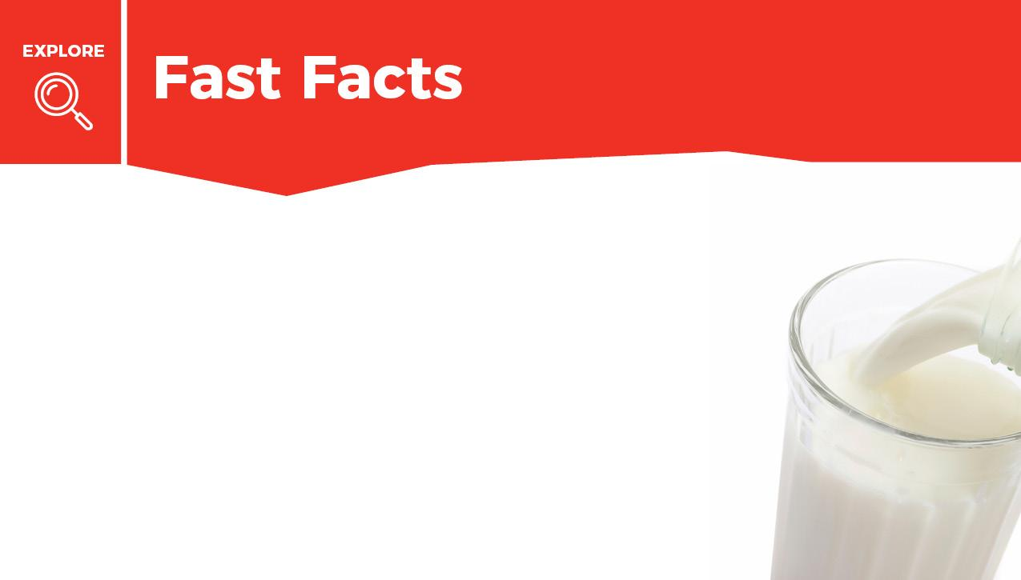



Mark done in the box when finished reading.
Water, milk, and 100% juice are the healthiest beverage choices. They help your body learn, play, and grow.
Milk is a healthy and nutritious beverage. It has important nutrients like calcium, protein, vitamin A, vitamin D, and more. These nutrients and others work together to help your body grow healthfully, develop strong bones, and lean muscle.
Whole fruits and vegetables give you many nutrients, but drinking 100% fruit juice can give you some of the same health benefits. Limit juice to 6 ounces (less than 1 cup) each day to make room for water and milk.

Slide 8
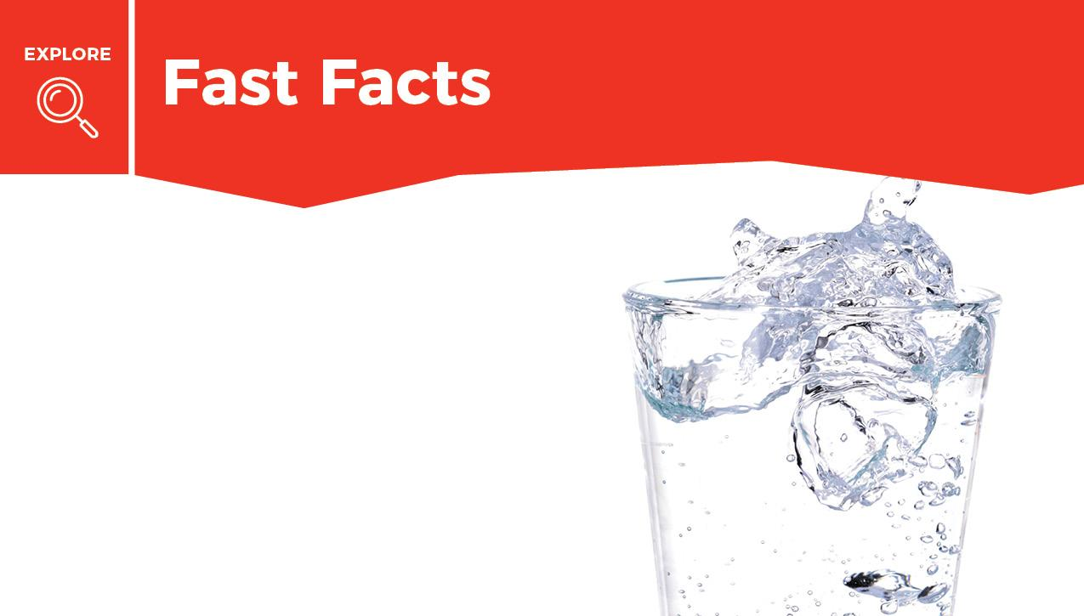
Mark done in the box when finished reading.
There are many beverage choices, and beverages are just as important to your health as the food you eat. Water is a healthy beverage.
Water is important for good health. Water helps cool your body by producing sweat, and it helps digest food by moving it through your body. It also removes waste.

Slide 9
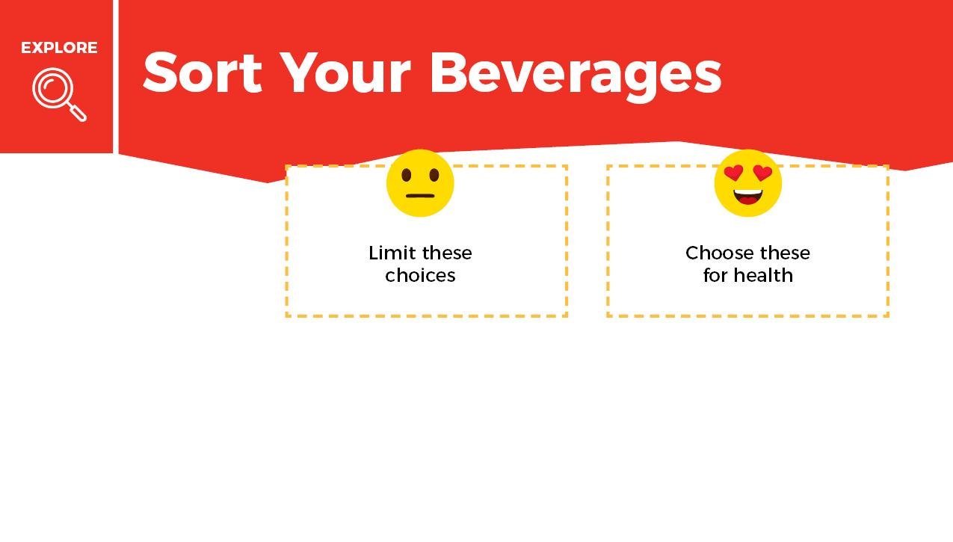

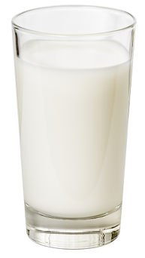
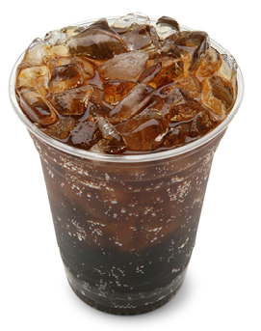
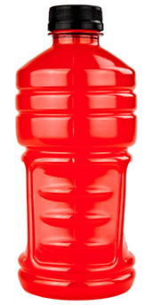
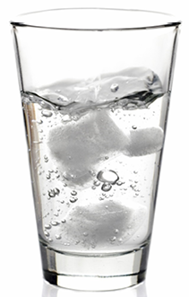
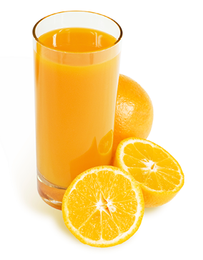
Sort the drinks into categories.
Choose more of the beverages that help your body.
Limit the beverages that do not help your body.
When you are finished put a check mark in the done box.
Milk
Soft drink
Sports drink
Water
Orange Juce

Slide 10
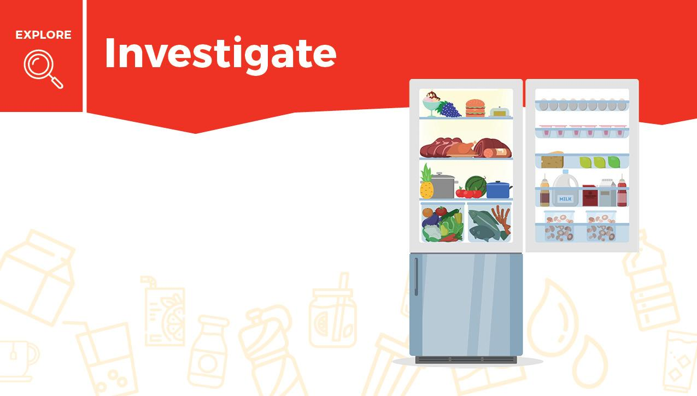
Think about what you drink each day. Complete the chart on the next slide using the information you learned about beverages.
Tip: Check your refrigerator or pantry to see what beverage choices you can make.

Slide 11


What do you drink? | How many times a week do you drink this? | Drag an emoji if your choice is helping your body.

Slide 12
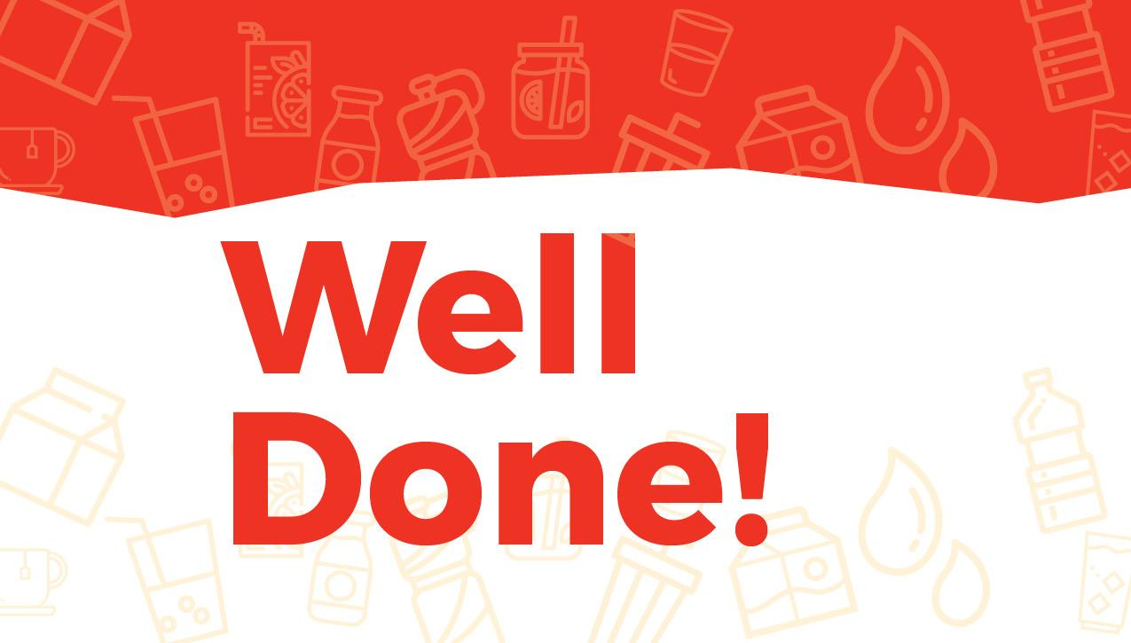

Slide 13
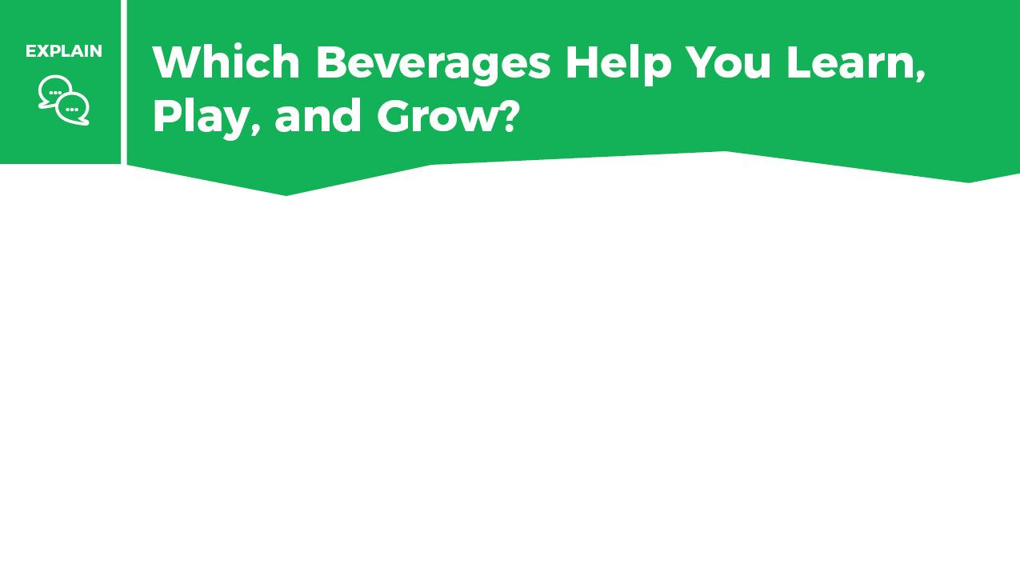
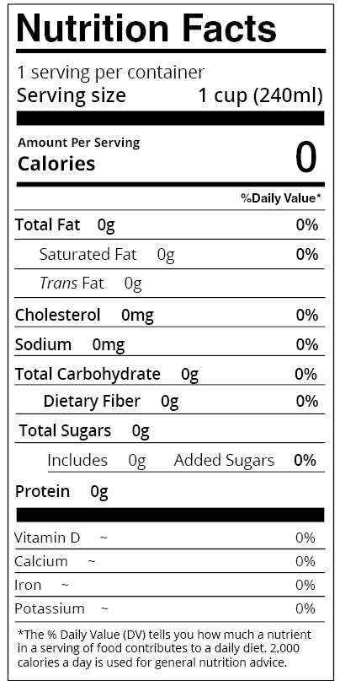
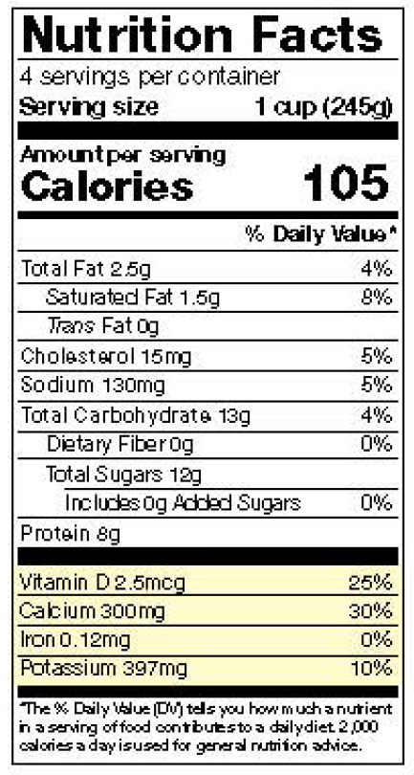
The label gives you clues about a drink and its health benefits.
Water has a lot of zeros on the label. That doesn’t mean it is not important. It is needed every day for your body to work properly!
Milk has nutrients to help build a healthy body and give you other health benefits.

Slide 14
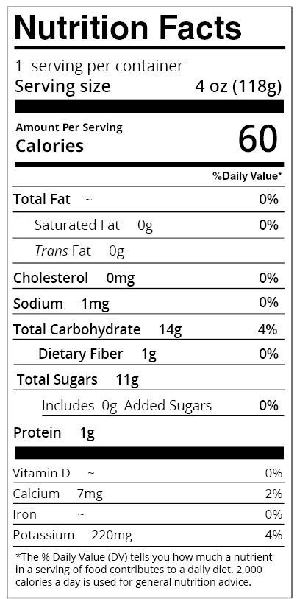
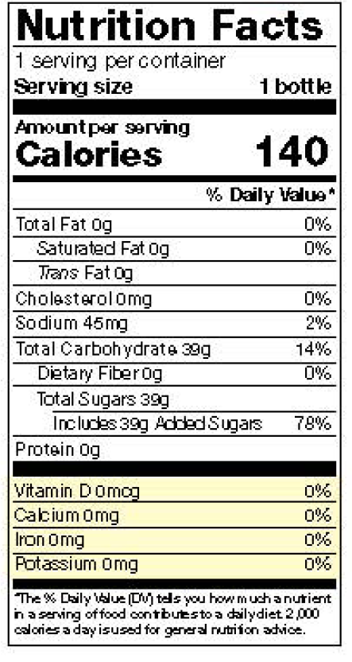
Drinking small amounts of 100% juice can give you some of the important nutrients found in whole fruits and vegetables, but eating whole fruits and vegetables is the best choice.
A soft drink has added sugar and does not give your body vitamins or health benefits.

Slide 15
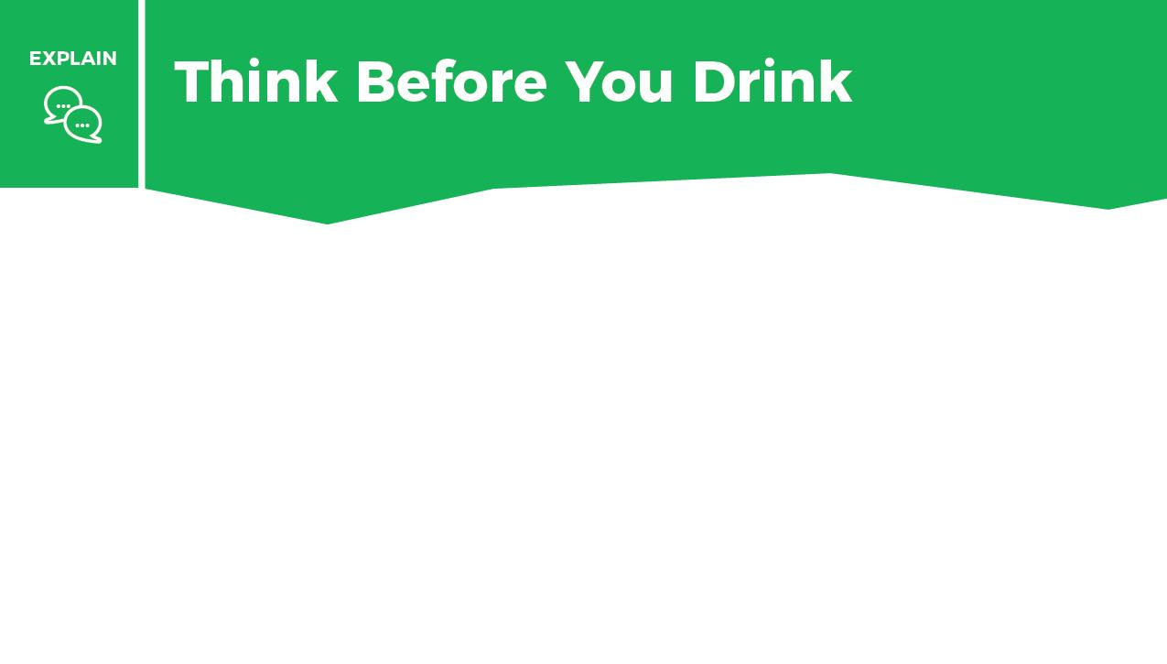


Imagine you made these drink choices today.
1. Drag the “keep” button if the drink provides you health benefits.
2. Drag the “swap” button if you would swap it for a better choice.
3. In the bottom box, write what you would swap it for.

Slide 16
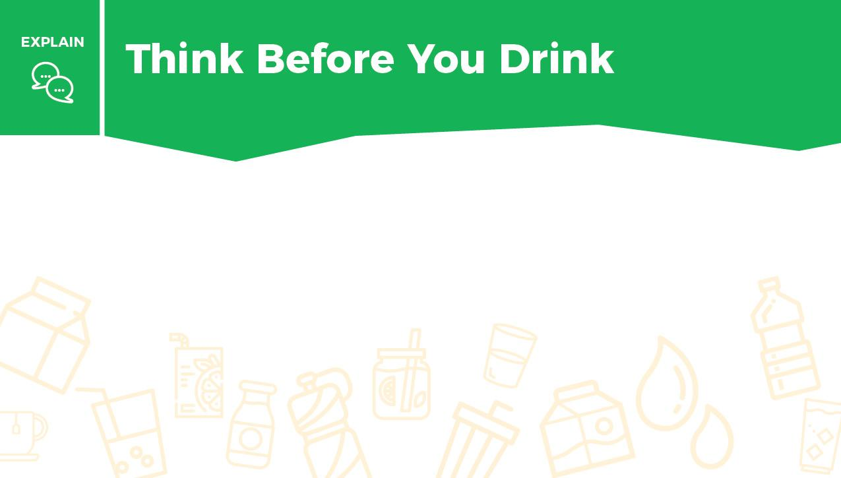
Write which beverage you will choose to help your body hydrate and stay healthy. Explain your choice.

Slide 17


Slide 18


Slide 19
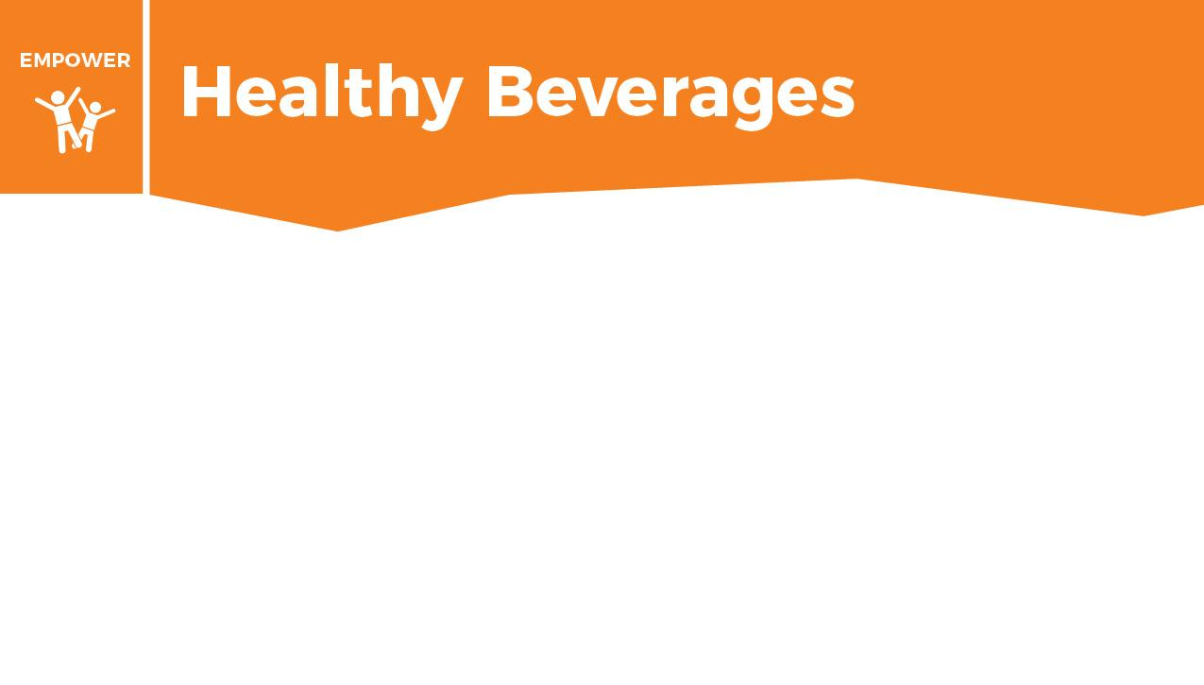
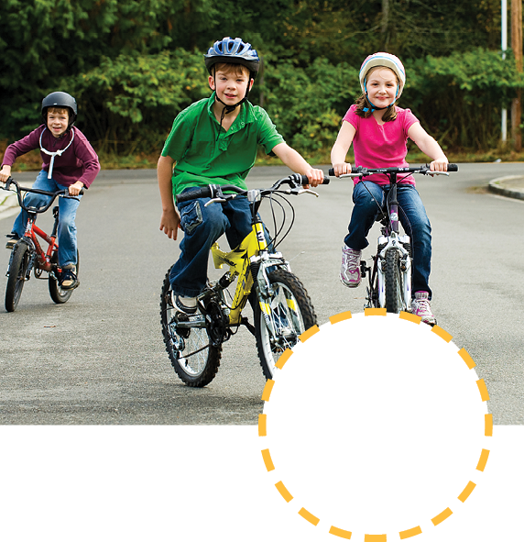


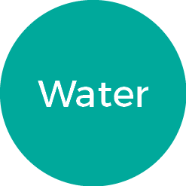
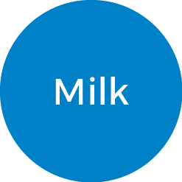
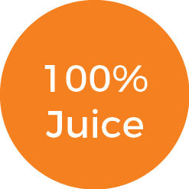
Choose which healthy beverage you will have during each activity by dragging the word next to the picture.
When you are finished put a check mark in the done box.

Slide 20

1. Reflect: What do you do well with your beverage choices?
2. Write a goal that will help you make more healthy beverage choices.
You can use this sentence frame: “I will drink more ____ and I will drink less _____.”

Slide 21


What was the last beverage you drank?
If it was a drink with added sugar and no nutrients, like soda or an energy drink, sprint 15 yards (15 giant steps), 10 times without stopping.
If it was milk or water, do a slow jog for 15 yards, 10 times without stopping.
Think about what made you more tired: sprints or jogging? Sprints show you how drinks with high amounts of sugar and no other nutrients go through your body. You may feel energetic at first, but then lose that energy fast.
With milk, your energy will last for a longer time, and you will have more energy throughout the day. Water will keep you hydrated and help you focus. Both beverages are healthy choices.

Slide 22


Slide 23
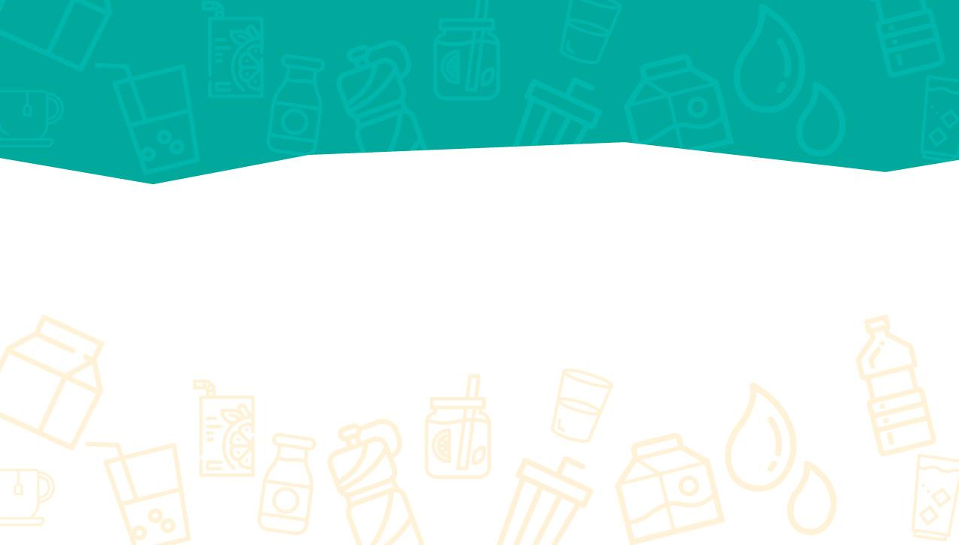
Please follow this link to a short survey to provide your feedback.
Encourage students to complete the short Knowledge Check after completing the Builder.

