Slide 1
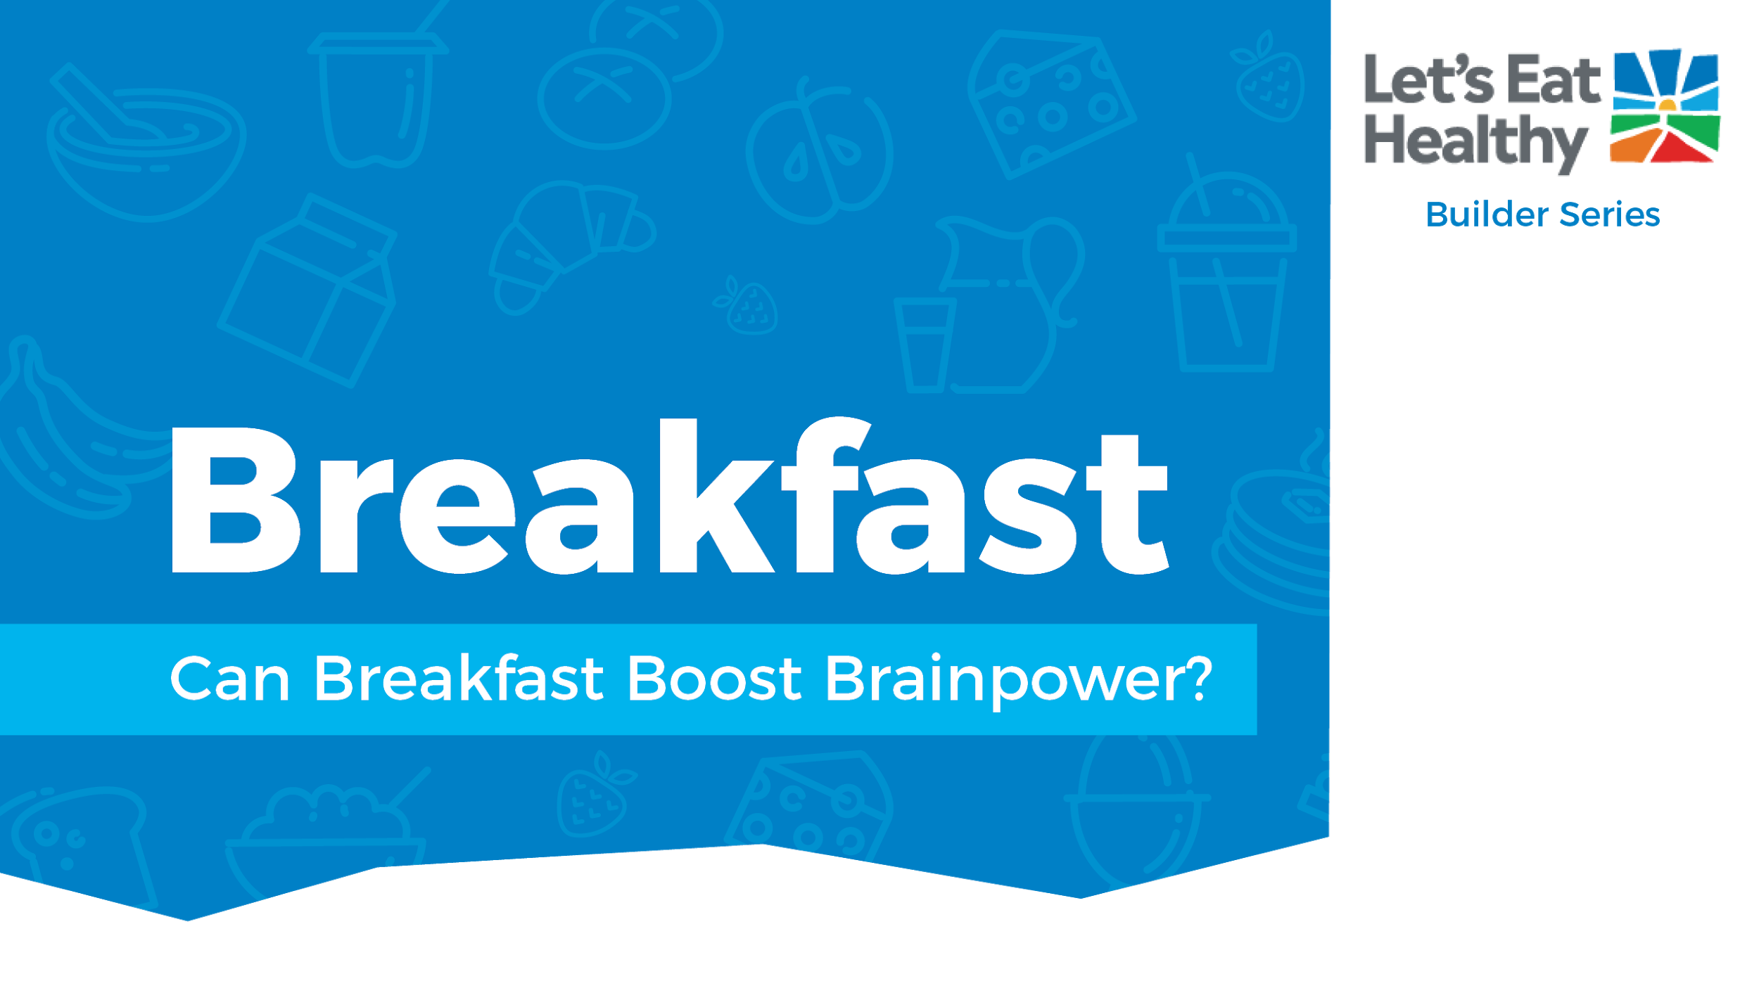

Notes:
Note for Educator: slides 2-6 are specifically for you. They include info on getting started with this activity, standards alignments, and fast facts on the topic. For students, copy slides 7-30 as a new slide deck, which can be shared as a file for each student in your Google classroom assignment or other digital platform.

Slide 2

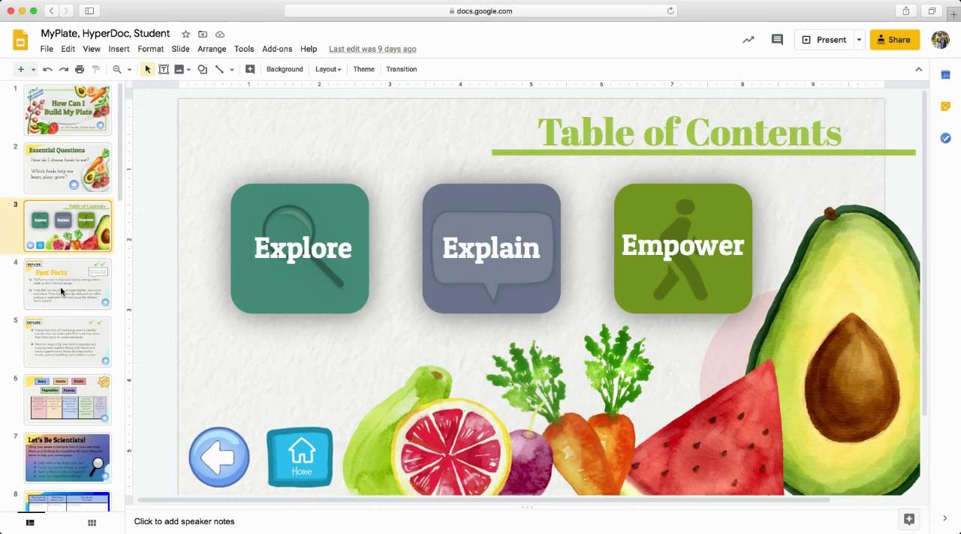

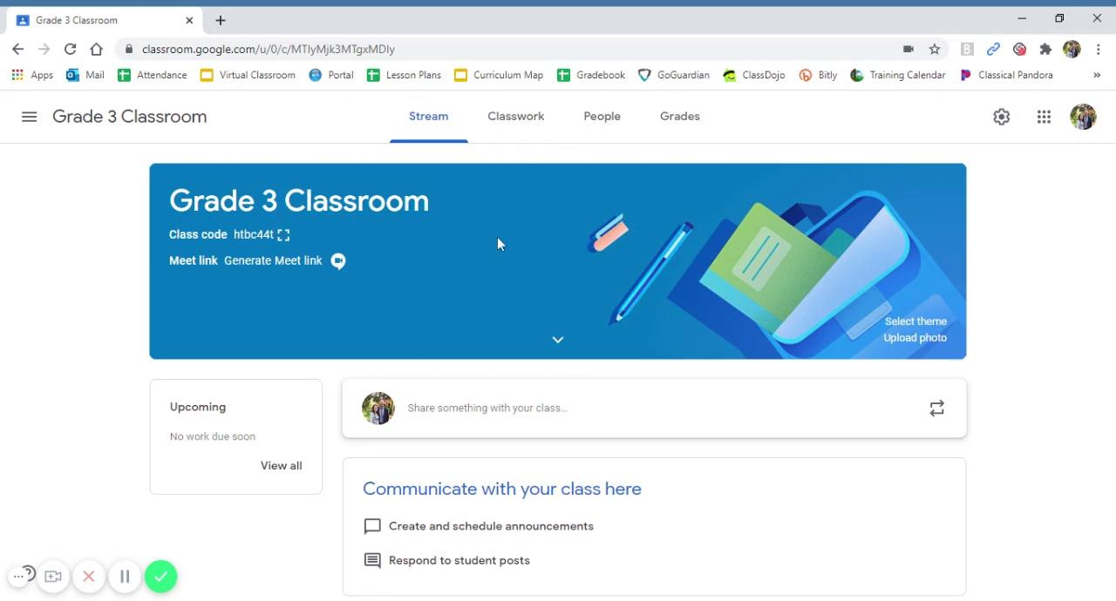


Navigating Digital Google Slides
Using HyperDoc:
You are using the Educator Guide, which includes notes and instructional videos.
Watch these 2 videos as an introduction to using the Builder Series.
The Builder Series is an interactive HyperDoc that includes aligned standards, facts, and slides labeled “Educator Guide” that are hidden from student view when presenting this material.
To make hidden slides viewable, simply select the slides, right click, and deselect Skip Slide.
Adding HyperDoc to Google Classroom:
Notes:
Note for Educator: slides 2-6 are specifically for you. They include info on getting started with this activity, standards alignments, and fast facts on the topic. For students, copy slides 7-30 as a new slide deck, which can be shared as a file for each student in your Google classroom assignment or other digital platform.

Slide 3

What foods can you choose to make a healthy breakfast?
Why is breakfast important?
Notes:
Note for Educator: slides 2-6 are specifically for you. They include info on getting started with this activity, standards alignments, and fast facts on the topic. For students, copy slides 7-30 as a new slide deck, which can be shared as a file for each student in your Google classroom assignment or other digital platform.

Slide 4
Section | Supported Standards CCSS-ELA | Rationale | RFM* CCSS – ELA | Supported Standards Health | Rationale | RFM* Health | Supported standards PE | Rationale
Explore | CCSS.ELA-LITERACY.RI.3.7 | Use information gained from illustrations (e.g., maps, photographs) and the words in a text to demonstrate understanding of the text | Brainstorm Breakfast foods with students. Compile list of foods they believe to be “healthy and unhealthy.” This will help with creating a breakfast plan
Explain | CCSS.ELA-LITERACY.RI.3.1 | Ask and answer questions to demonstrate understanding of a text, referring explicitly to the text as the basis for the answers. | remind students of how to properly create or build a breakfast. Choosing foods from at least three food groups.
Apply |  |  |  | 6.1.P | Set a short-term goal for positive health practices
Physical Activity |  |  |  | Grade 4: 1.3.N, 1.6.N, 5.1.N, 5.2.N, 7.1.N, 7.2.N, 7.4.N Grade 5: 1.3.N, 1.6.N, 1.8.N, 5.1.N, 5.2.N, 7.1.N |  |  | Grade 3: 3.3, 3.4, 3.7 Grade 4: 3.3, 3.4, 3.7, 4.6 Grade 5: 3.2, 3.3, 3.5, 3.7
Notes:
Note for Educator: slides 2-6 are specifically for you. They include info on getting started with this activity, standards alignments, and fast facts on the topic. For students, copy slides 7-30 as a new slide deck, which can be shared as a file for each student in your Google classroom assignment or other digital platform.

Slide 5

Breakfast provides the first fuel of the day. Starting the day with breakfast is a healthy habit associated with better health, better learning, and higher diet quality. Eating breakfast also eliminates hunger symptoms like being tired or sleepy, getting headaches, or becoming cranky.
It is important for children to have breakfast every day, but what they eat is crucial, too. Choosing foods from 3 different food groups helps to sustain energy, feel full longer, and maximize nutrients. Aim to combine foods that are rich in whole grains, fiber, and protein, but low in added sugars. As an example, combine yogurt with granola and berries.
Notes:
Note for Educator: slides 2-6 are specifically for you. They include info on getting started with this activity, standards alignments, and fast facts on the topic. For students, copy slides 7-30 as a new slide deck, which can be shared as a file for each student in your Google classroom assignment or other digital platform.

Slide 6


Most schools participate in the School Breakfast Program. This program provides a nutritious breakfast for children at low or no cost. All meals served as part of the breakfast program must meet nutrient and quality standards.
Other innovative breakfast programs like Breakfast in the Classroom are offered in many schools. There are many options available to provide breakfast to children.
Notes:
Note for Educator: slides 2-6 are specifically for you. They include info on getting started with this activity, standards alignments, and fast facts on the topic. For students, copy slides 7-30 as a new slide deck, which can be shared as a file for each student in your Google classroom assignment or other digital platform.

Slide 7
Notes:
Student slides begin

Slide 8






Slide 9
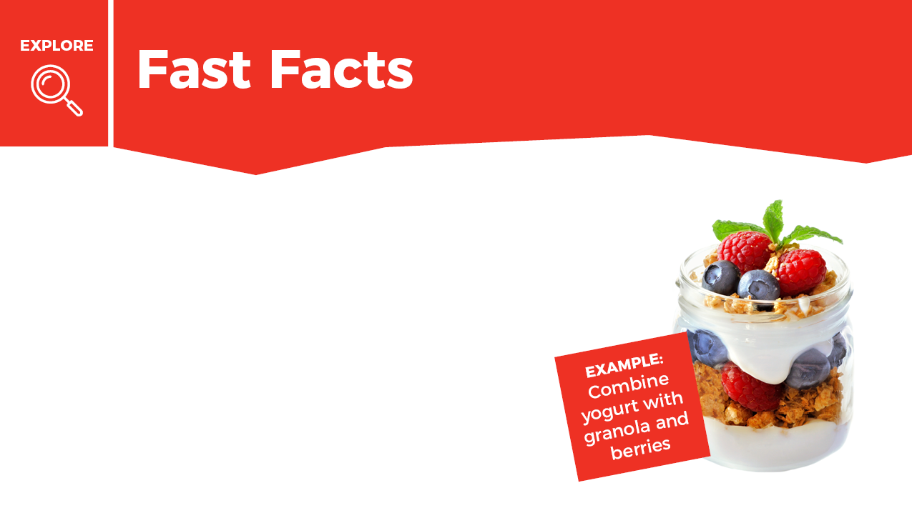



Mark done in the box when finished reading.
Breakfast is the first fuel of the day. Starting the day with breakfast is a healthy habit that helps you learn, play, and grow.
It is important to eat breakfast every day. Choosing foods from 3 different food groups (Dairy, Vegetables, Fruits, Grains, and Protein) helps give you energy and feel full longer.

Slide 10

Mark done in the box when finished reading.
Most schools offer a nutritious breakfast that includes foods from 3 of the 5 food groups.
The breakfast pictured here is another example of a healthy, balanced breakfast. Can you name the foods and what food group they belong to? (Hint: This breakfast includes 4 of the five good groups).

Slide 11

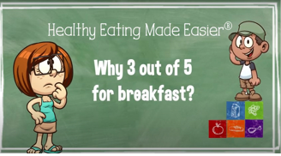
Check out this video!
Foods from at least 3 of the 5 food groups build a healthy breakfast pattern.
Breakfast is important because it provides the first fuel of the day. It gives you energy to learn and play.

Slide 12


Slide 13

Breakfast foods give you fuel, or energy, to start you off ready to learn and play. The pictures show what having energy looks like!

Slide 14

What can you do to eat breakfast every day? You can eat breakfast at home or at school. You can help your family make breakfast. Or maybe you can help shop for favorite breakfast foods at the store.
Write about why you think breakfast is important to eat every morning.

Slide 15


Slide 16
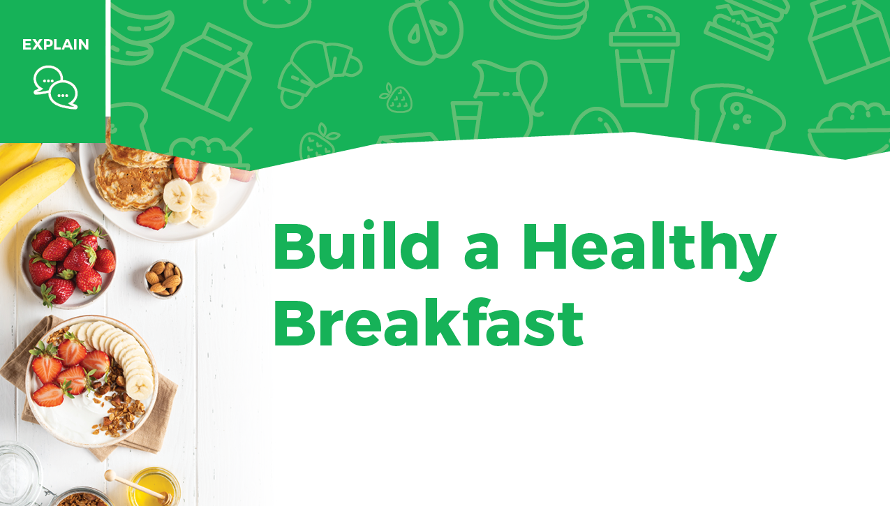
Many foods can be combined to build a healthy breakfast.

Slide 17
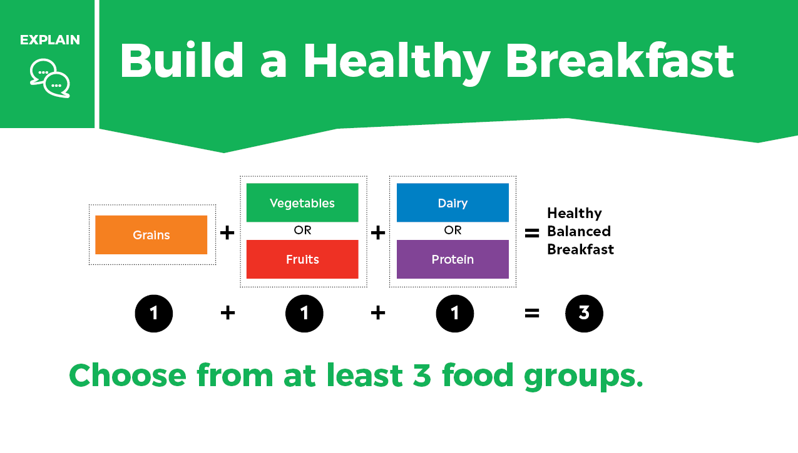

Slide 18
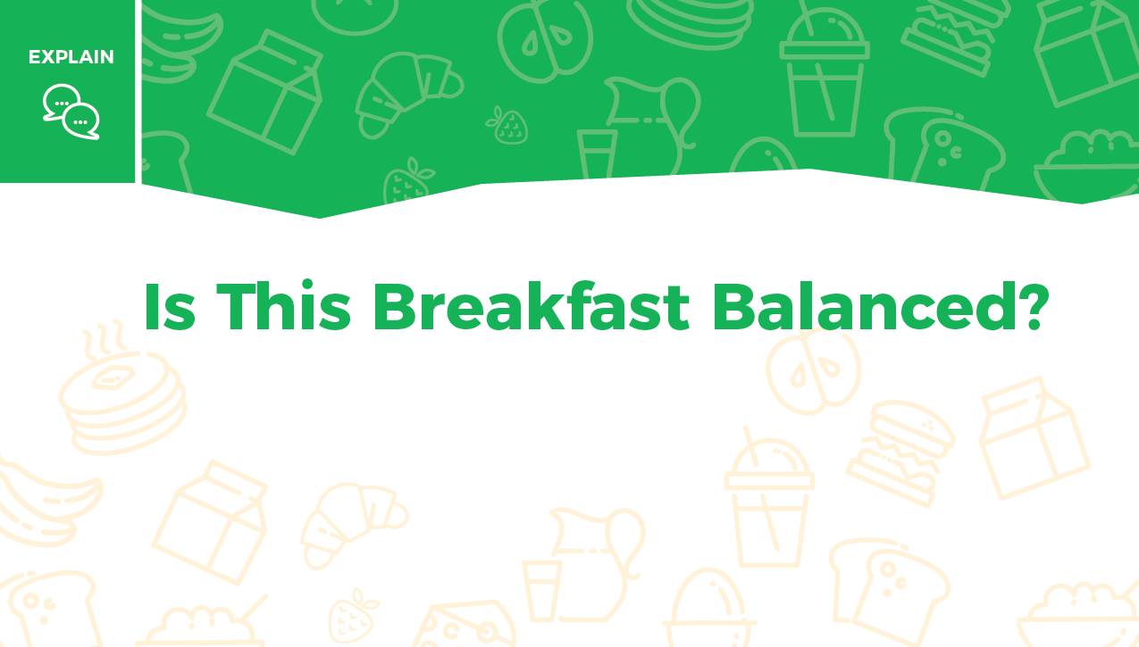
Look at the 3 breakfasts pictured on the next 3 slides.
Type the food groups you see included in each breakfast picture.

Slide 19
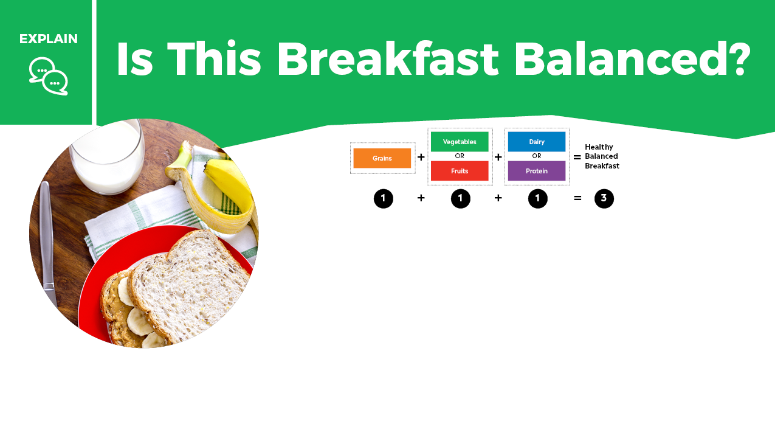

What food groups are included in the breakfast?
Whole-grain bread with peanut butter, banana and glass of milk
Is this
breakfast
balanced?

Slide 20
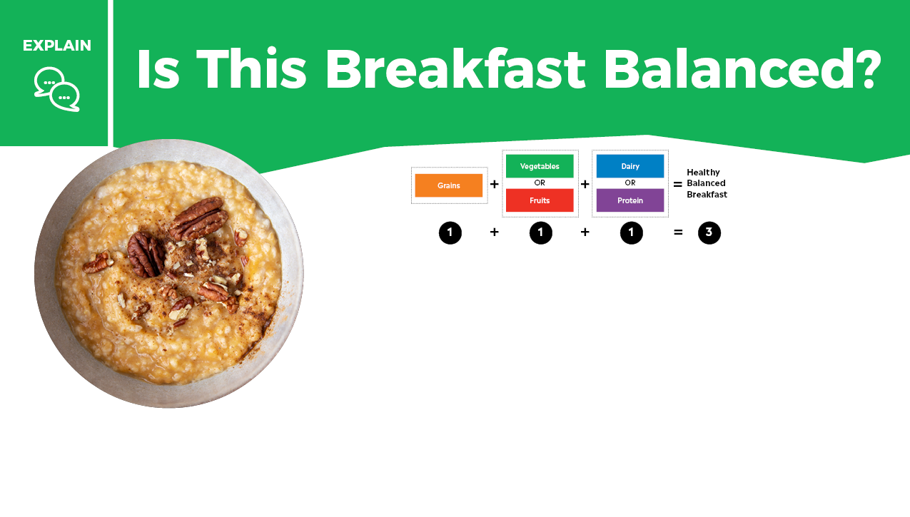
What food groups are included in the breakfast?
Oatmeal with nuts and water
Is this
breakfast
balanced?

Slide 21
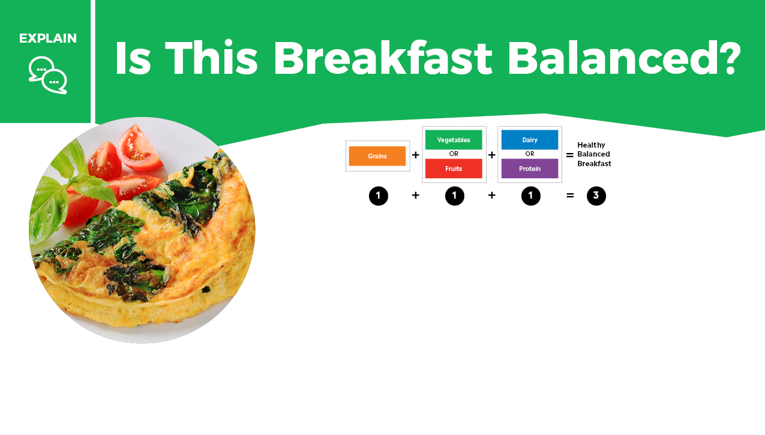
What food groups are included in the breakfast?
Vegetable and cheese omelet
Is this
breakfast
balanced?

Slide 22

Were there any breakfasts that were not balanced?
What food could you add to make it balanced?
What food group does that food belong to?

Slide 23


Slide 24



Instructions
On the next slide, list 3 foods from 3 different food groups that you would like to eat for your own breakfast.
Next to each food, write the name of the food group. Ask your teacher or a family member to help you locate your school breakfast menu online. This may give you some ideas, too.

Slide 25
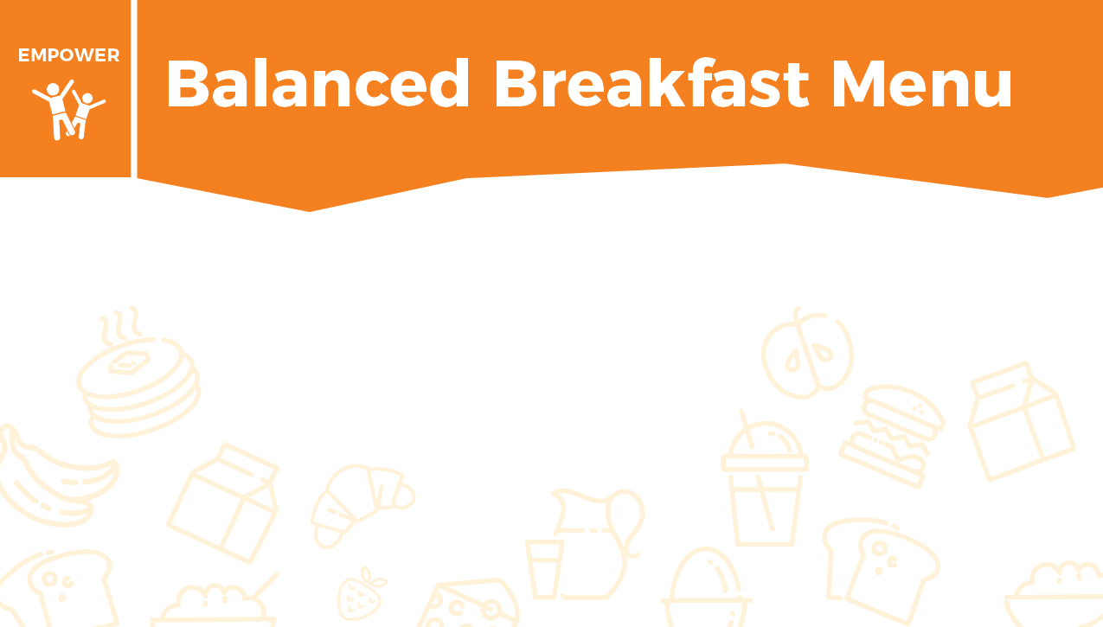
Food Group
Food
Use the 3 out of 5 rule by using grains + fruit or vegetable + dairy or protein.

Slide 26
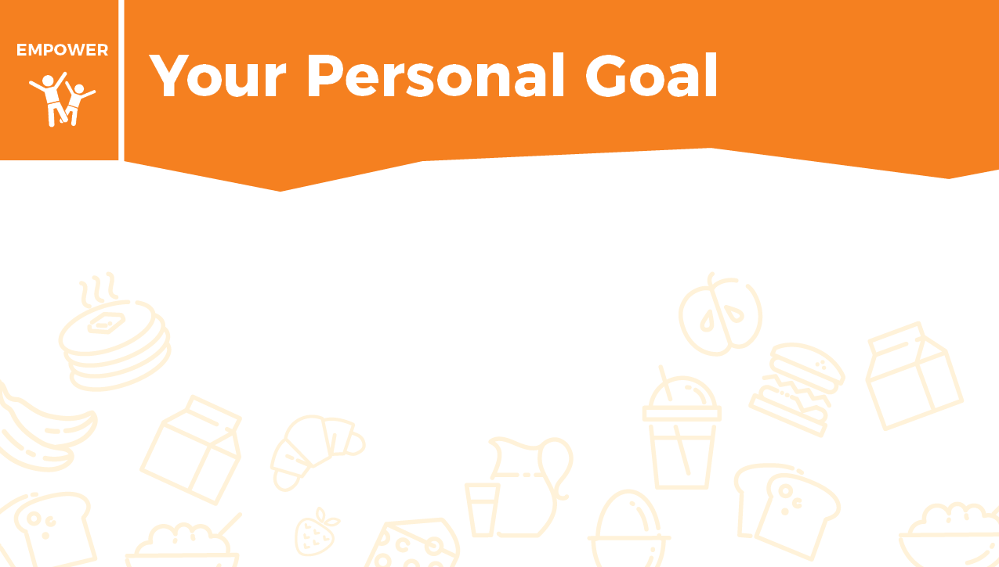
Now it is time to turn your plan into action. Share this menu with your family. Offer to help prepare this breakfast for everyone to enjoy!
At home you can help with breakfast by:

Slide 27


Think of a complete breakfast that includes 3 out of 5 food groups. The 5 food groups help your body learn, play, and grow.
Which food group makes up the biggest part of your breakfast? Do 15 repetitions of that exercise without stopping. For your second food, do 10 repetitions. For the last food, do 5 repetitions. Repeat 3 times.
Dairy helps build strong bones and teeth = squat jumps
Vegetables support healthy skin and eyes = plank
Fruits aid in healing = downward-facing dog to snake pose
Grains give the body energy = burpees
Protein builds strong muscles = push-ups
Watch how to do the exercises!

Slide 28

Example:
A complete breakfast could be peanut butter toast with milk.
Milk = Dairy: Do 15 squat jumps.
Peanut Butter = Protein: Do 10 push-ups.
Toast = Grains: Do 5 burpees.
Repeat 3 times.

Slide 29


Check out these tasty breakfast recipes.

Slide 30
Take this short Knowledge Check to show what you learned.

