Slide 1
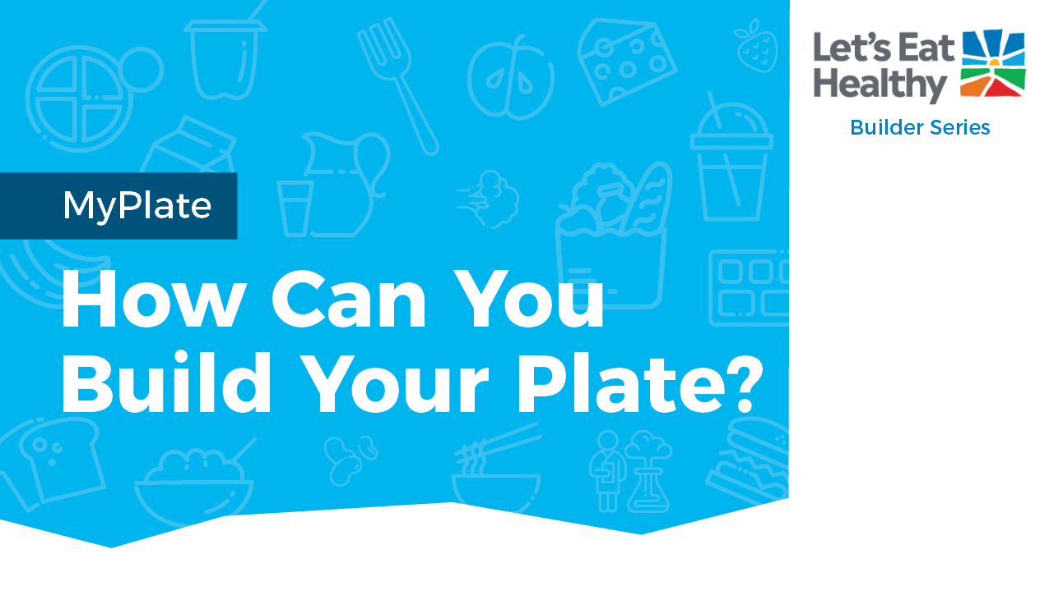

Notes:
Note for Educator: slides 2-4 are specifically for you. They include info on getting started with this activity, standards alignments, and fast facts on the topic. For students, copy slides 5-33 as a new slide deck, which can be shared as a file for each student in your Google classroom assignment or other digital platform.

Slide 2
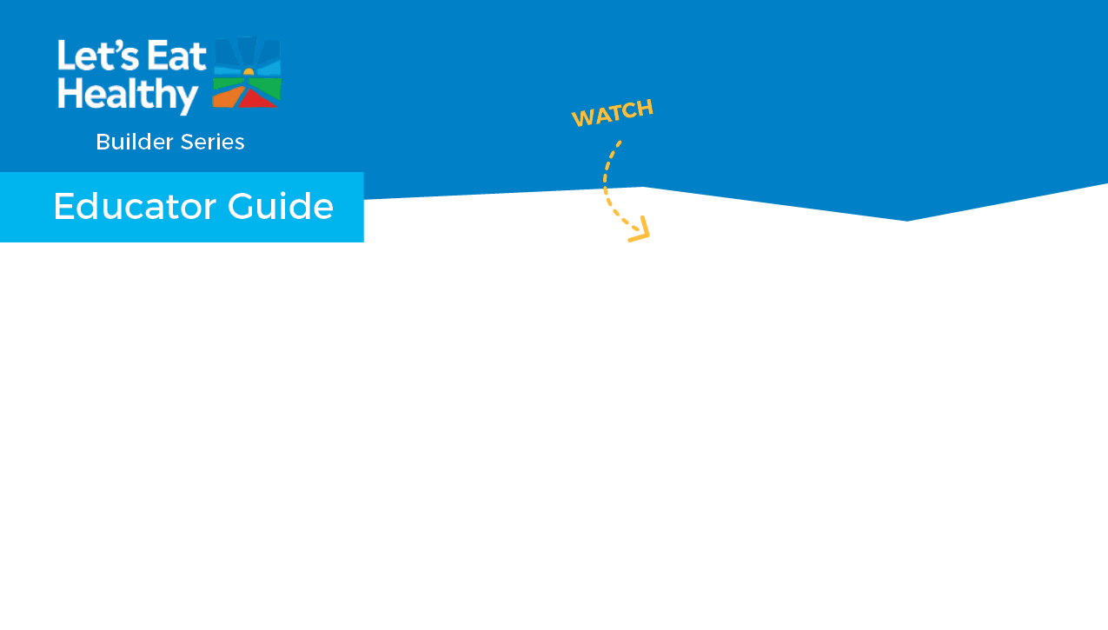
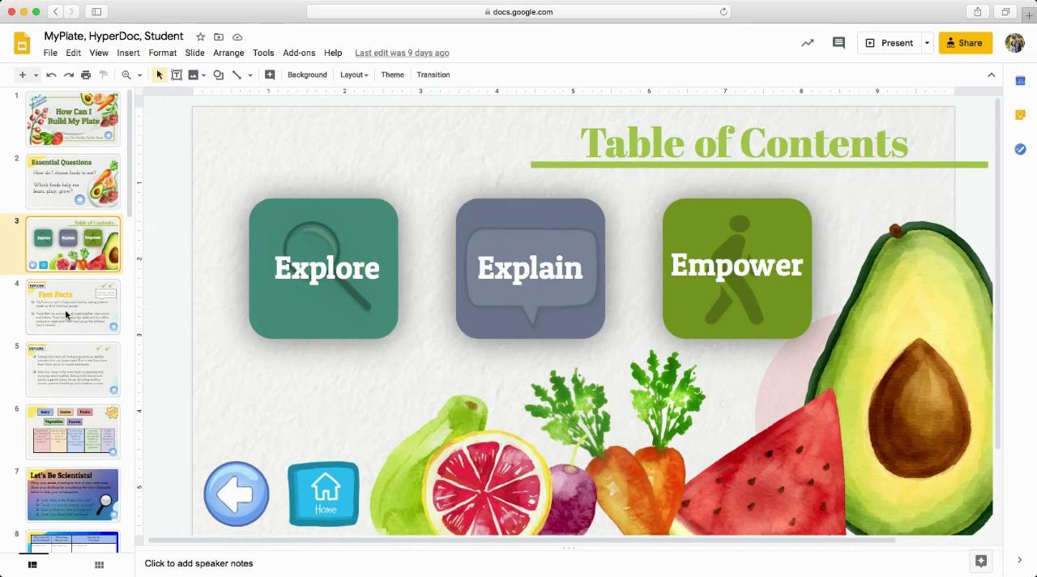

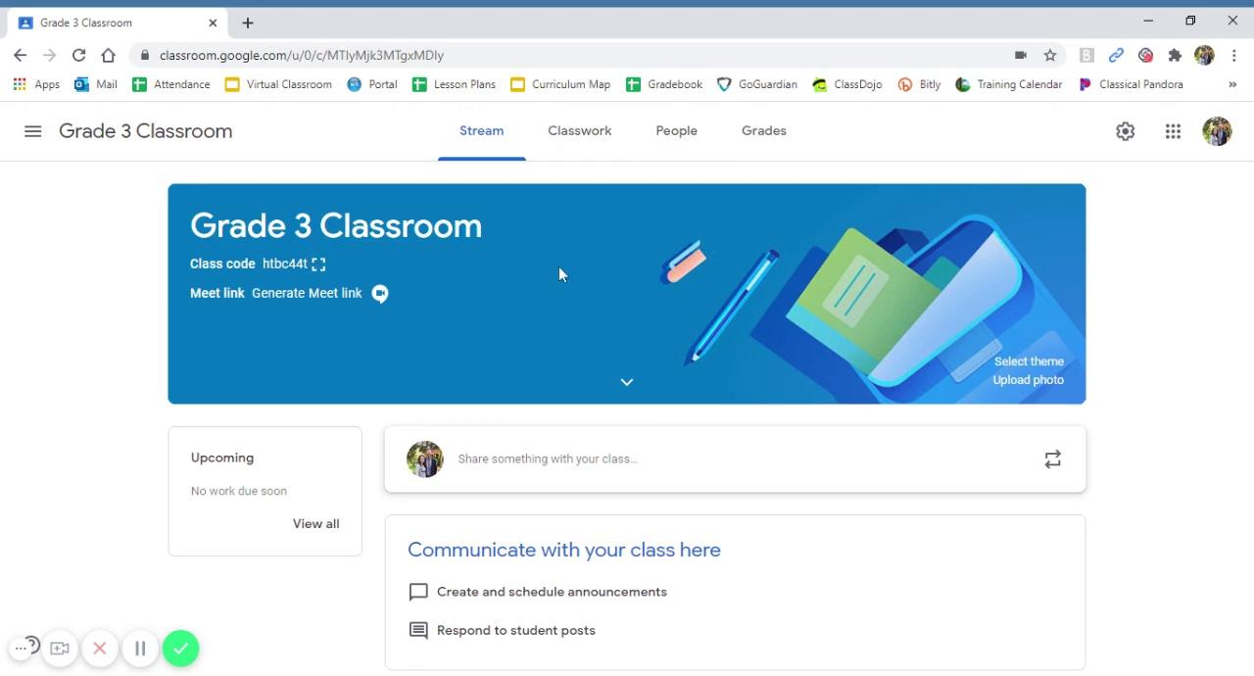


Navigating Digital Google Slides
Using HyperDoc:
You are using the Educator Guide, which includes notes and instructional videos.
Watch these 2 videos as an introduction to using the Builder Series.
The Builder Series is an interactive HyperDoc that includes aligned standards, facts, and slides labeled “Educator Guide” that are hidden from student view when presenting this material.
To make hidden slides viewable, simply select the slides, right click, and deselect Skip Slide.
Adding HyperDoc to Google Classroom:
Notes:
Note for Educator: slides 2-4 are specifically for you. They include info on getting started with this activity, standards alignments, and fast facts on the topic. For students, copy slides 5-33 as a new slide deck, which can be shared as a file for each student in your Google classroom assignment or other digital platform.

Slide 3
Section | Supported Standards CCSS-ELA | Rationale | Modifications CCSS – ELA | Supported Standards Health | Rationale | Modifications Health | Supported standards PE | Rationale
Explore | 3.RI.05 | Use text features & search tools (e.g., key words, sidebars, hyperlinks) to locate information relevant to a given topic efficiently | Provide explanation on how to navigate online resources | 7.1.G | Determine behaviors that promote healthy growth and development | Discuss various activities students do that are healthy
Explain | 3.RI.01 | Ask & answer questions to demonstrate understanding of a text, referring explicitly to the text as the basis for the answers
Apply |  |  |  | 6.1.P | Set a short-term goal for positive health practices
Physical Activity |  |  |  | Grade 4: 1.3.N, 1.6.N, 5.1.N, 5.2.N, 7.1.N, 7.2.N, 7.4.N Grade 5: 1.3.N, 1.6.N, 1.8.N, 5.1.N, 5.2.N, 7.1.N |  |  | Grade 3: 1.1, 3.2 Grade 4: 3.2, 3.7 Grade 5: 3.2, 4.1
Notes:
Note for Educator: slides 2-4 are specifically for you. They include info on getting started with this activity, standards alignments, and fast facts on the topic. For students, copy slides 5-33 as a new slide deck, which can be shared as a file for each student in your Google classroom assignment or other digital platform.

Slide 4

Food grouping makes detailed eating guidelines simple. MyPlate is a tool to help build healthy eating patterns made up of all food groups.
Foods that have similar nutrients are grouped together. Each food group provides a specific and unique health benefit
Foods work together to give the greatest health benefits. Eating a variety of foods from all food groups provides a wide range of the key nutrients children need for growth and development. Plan to combine several food groups for meals and snacks.
Shared food experiences like preparing and enjoying meals together creates connection. Shared meals support better health, nutrition, social and emotional skills and academic success.
Notes:
Note for Educator: slides 2-4 are specifically for you. They include info on getting started with this activity, standards alignments, and fast facts on the topic. For students, copy slides 5-33 as a new slide deck, which can be shared as a file for each student in your Google classroom assignment or other digital platform.

Slide 5
Notes:
Student slides begin

Slide 6
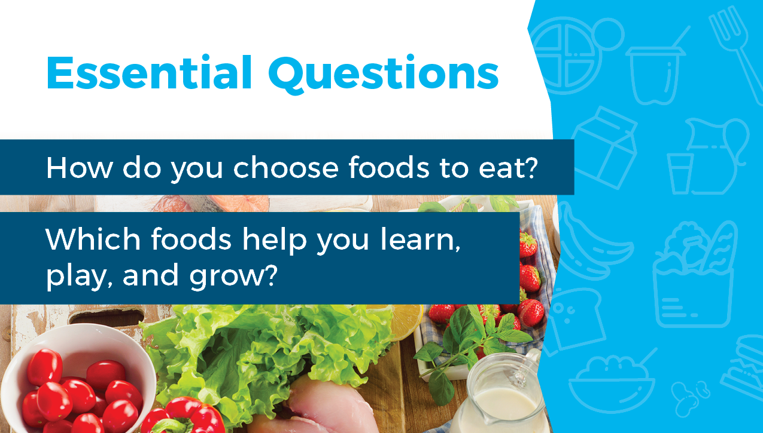

Slide 7
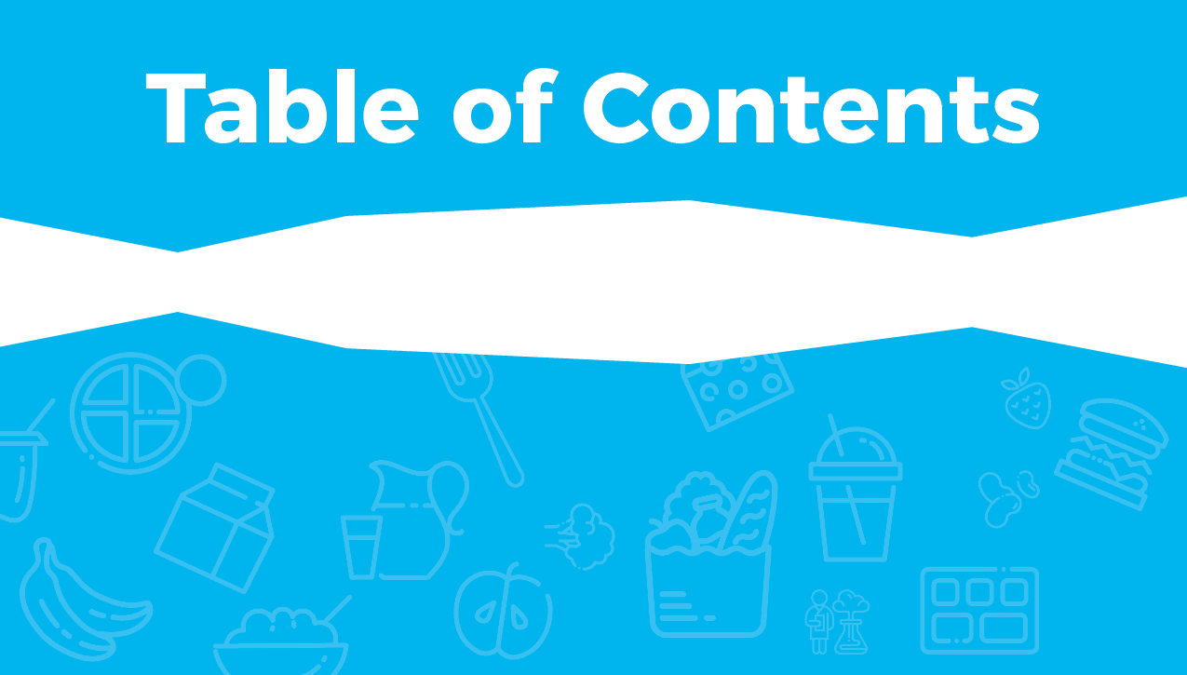





Slide 8



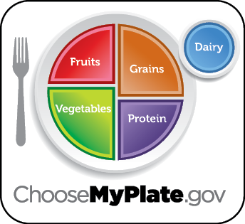

Mark done in the box when finished reading.
MyPlate is a tool to help build healthy eating patterns using the 5 food groups.
Similar foods like carrots and lettuce are grouped together. These foods are grown from seeds and are called vegetables. Each food group has different health benefits.

Slide 9

Mark done in the box when finished reading.
Eating foods from all food groups gives you healthy nutrients that your body needs to learn, play, and grow. Plan to eat from more than 1 food group for meals and snacks.
Ask to help with food preparation or cooking to learn about new foods and how to prepare them.

Slide 10


Check out this video!
Each food group has specific health benefits. On the next slide, see if you can match the correct health benefits to the food group by dragging it to the right box. When you’re done, put a check in the box.

Slide 11
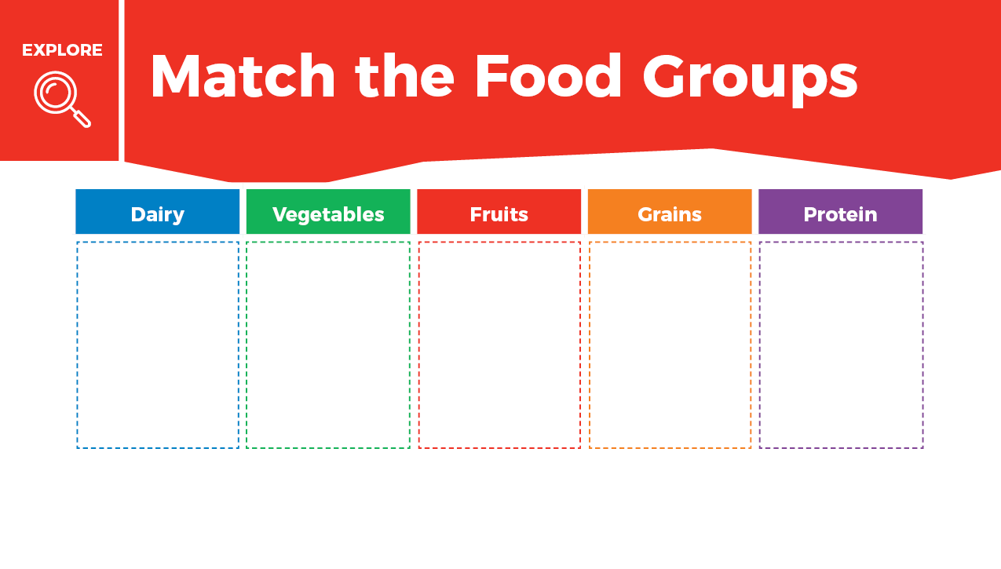

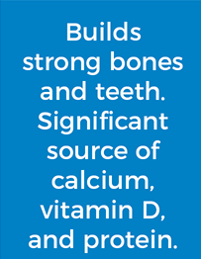
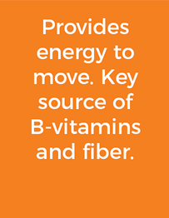
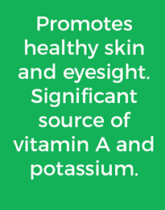
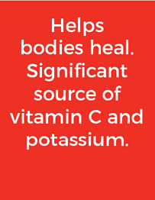


Slide 12


Using your senses (sight, touch, smell, taste, and hearing), investigate food at your next meal. Share your findings by completing the chart on the next slide. Use the examples below to help your investigation.
Sight: What is the shape, color, and size?
Touch: Is it smooth, bumpy, or rough?
Smell: Is there an odor or fragrance?
Taste: How does it taste? Salty? Sweet? Spicy?
Hearing: Does it crunch, pop, or snap?

Slide 13
What food did you investigate?
What senses did you use?
Describe the food here.

Slide 14


Slide 15
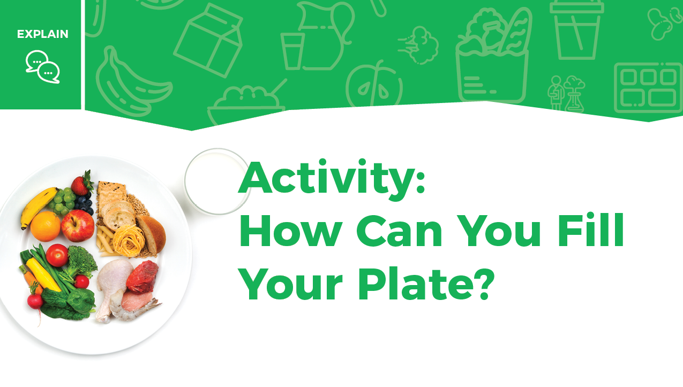

Slide 16
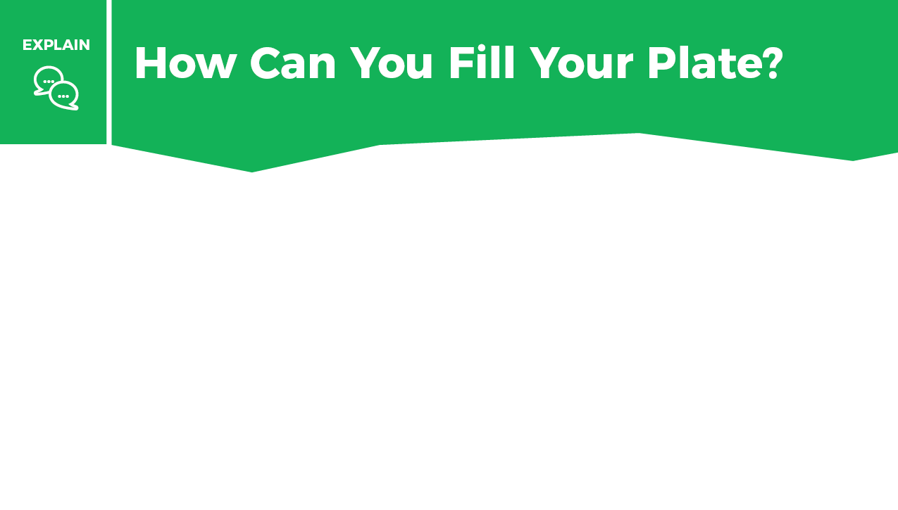
Instructions
On the next 2 slides a meal is shown. One food group is missing from each meal. Identify the missing food group and write the name of the group. What food could you add to complete the meal?

Slide 17
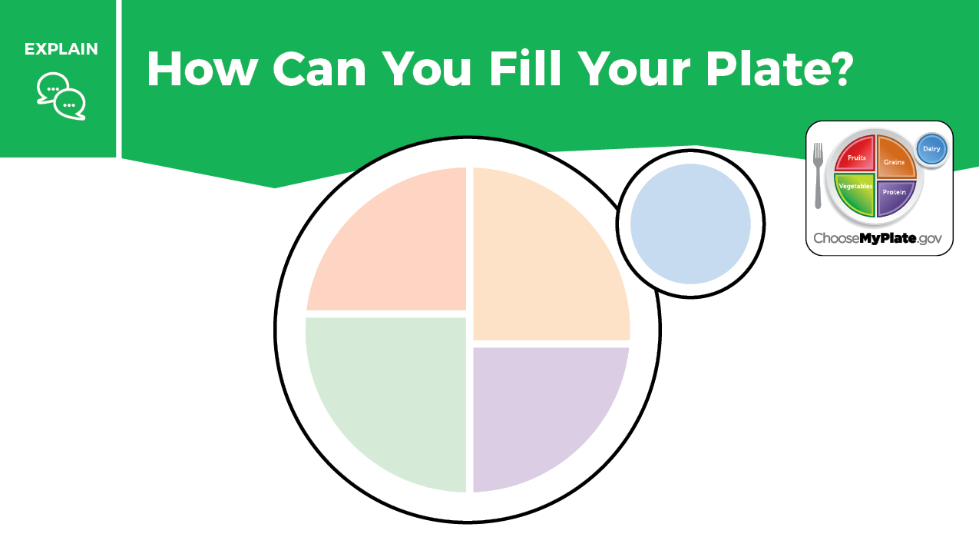

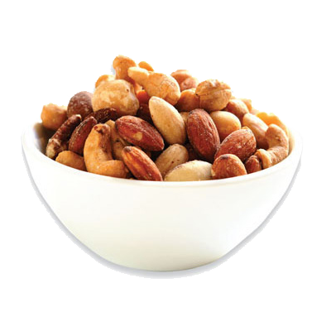
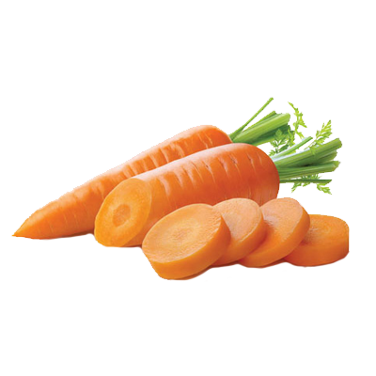
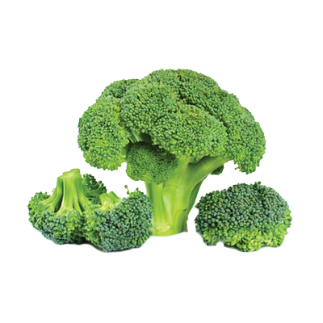
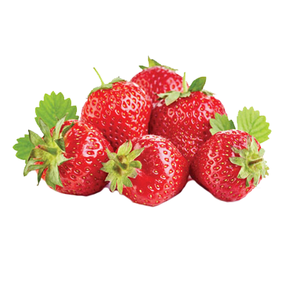

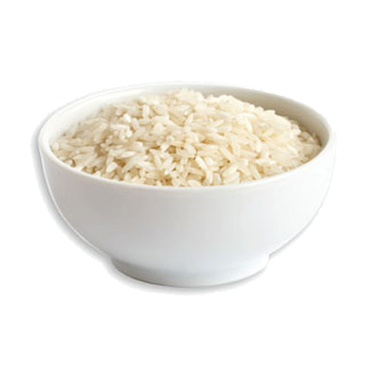

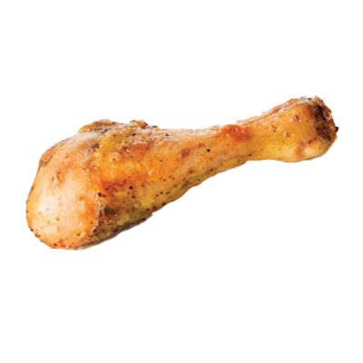
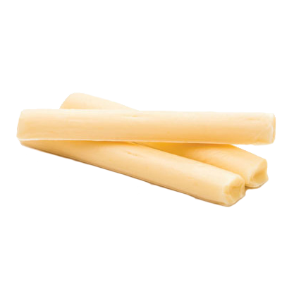

Slide 18
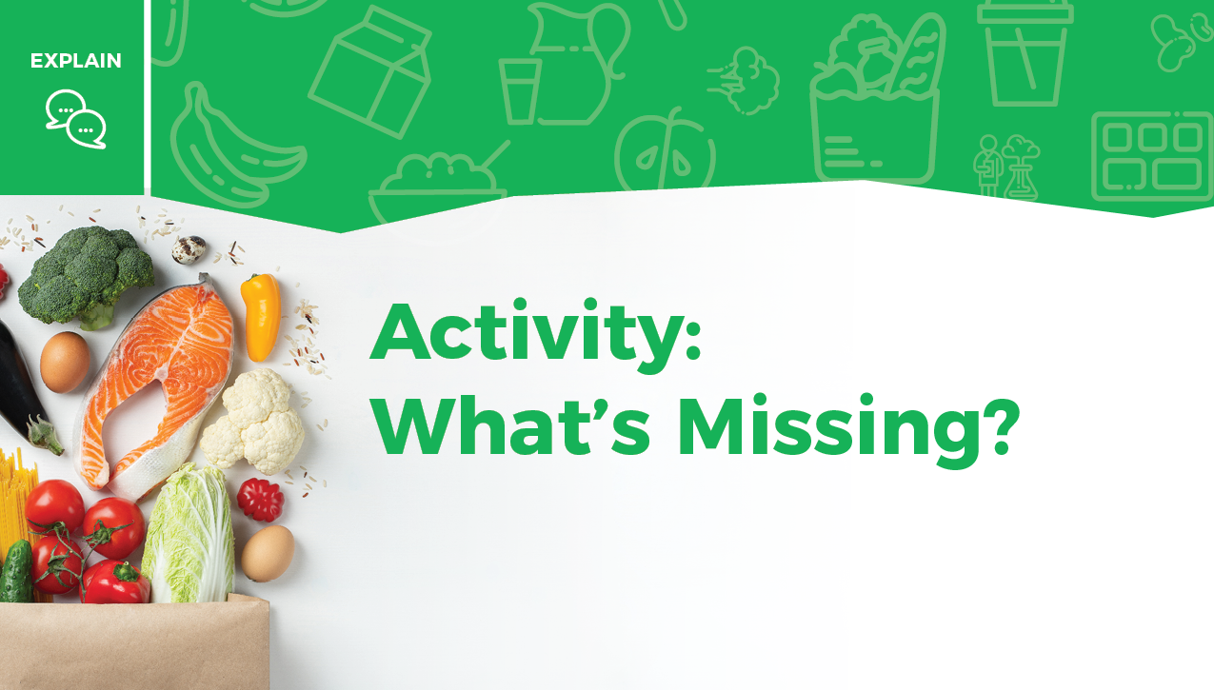

Slide 19
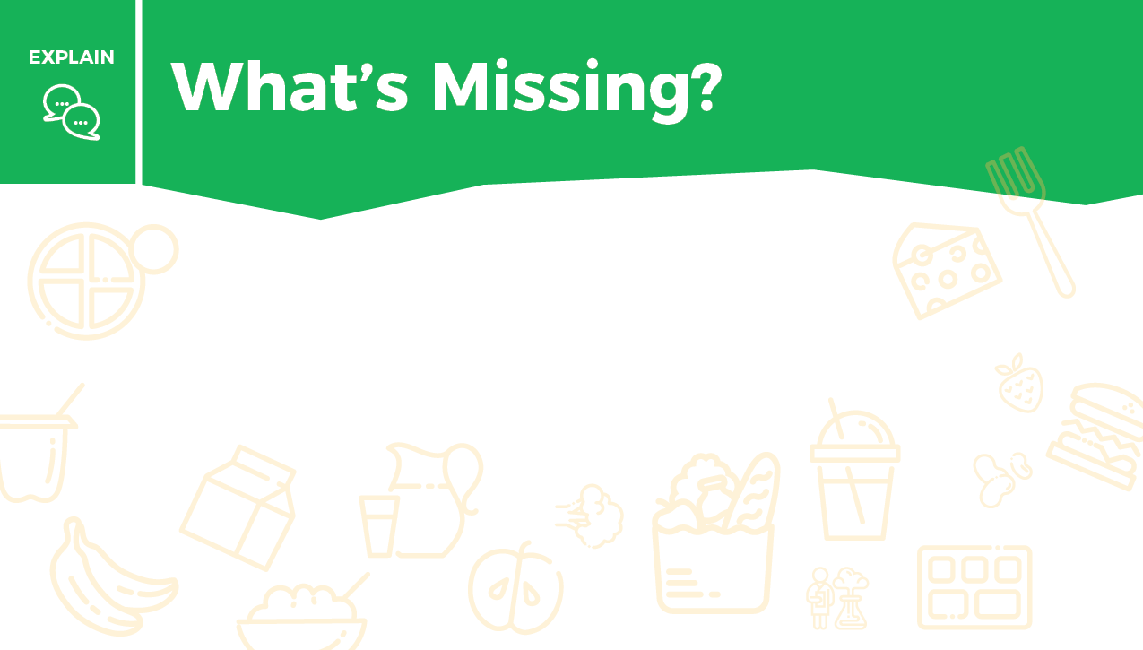
Instructions
On the next 2 slides a meal is shown. One food group is missing from each meal. Identify the missing food group and write the name of the group. What food could you add to complete the meal?

Slide 20

What food group is missing?
What food can you add?
Peanut butter and banana sandwich with a glass of milk

Slide 21

What food group is missing?
What food can you add?
Tacos with tortillas, hamburger, lettuce, tomato, and cheese

Slide 22
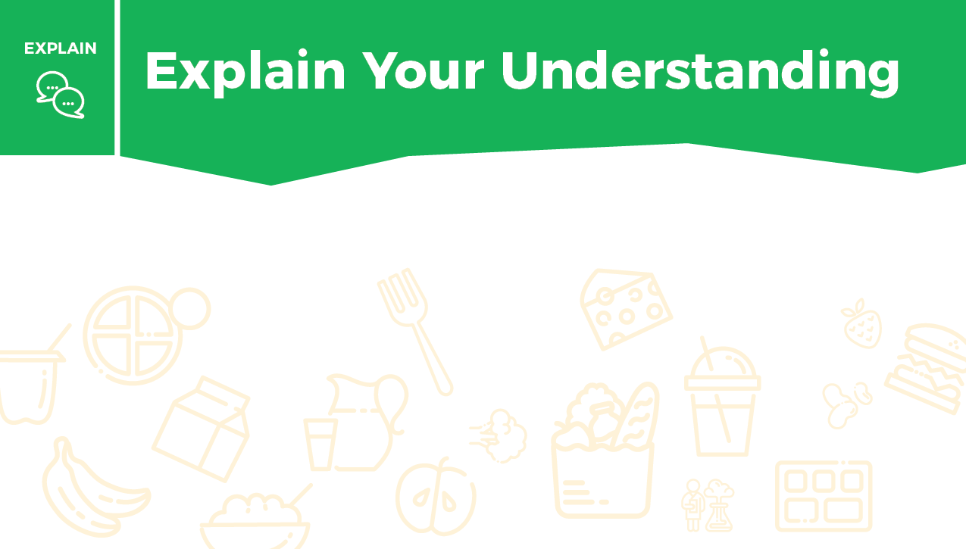
Using your knowledge of how to build a plate that includes all food groups, write 3–4 sentences about the importance of eating from ALL food groups.

Slide 23


Slide 24


Slide 25
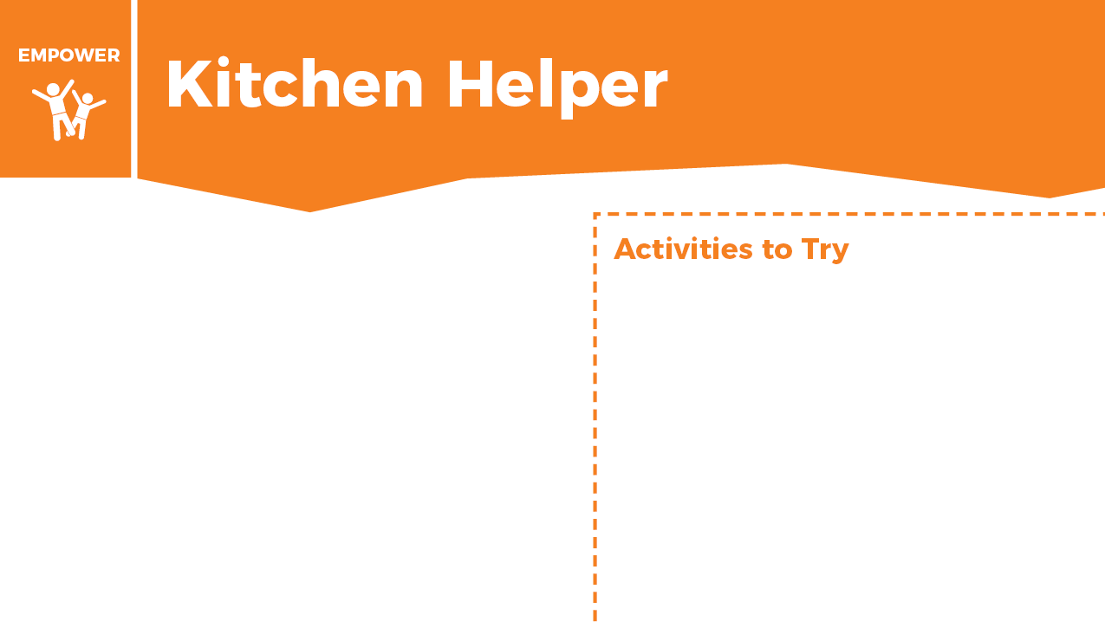







What activities would you be willing to start doing at home? Drag your choices to the box on the right.

Slide 26


Slide 27

Instructions
On the next slide, drag a circle around 2 new foods you could try as a part of a meal or snack. When you have completed this activity put a check mark in the box.

Slide 28

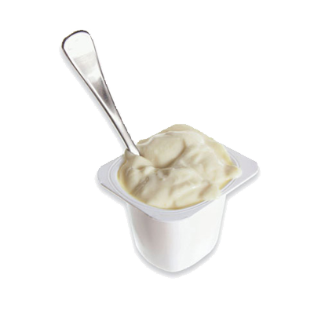
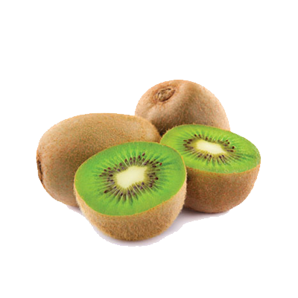
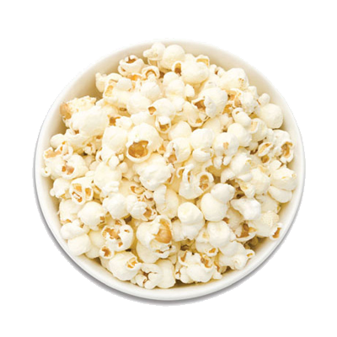

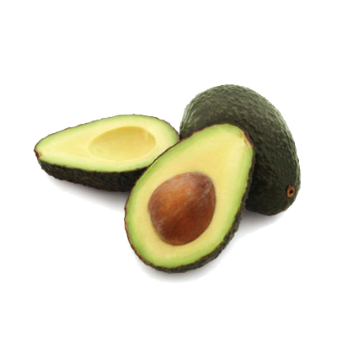
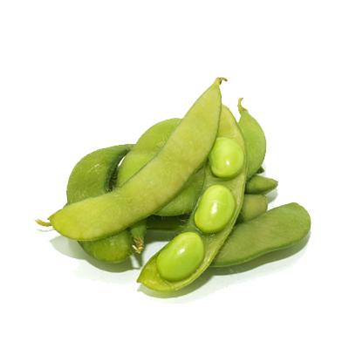
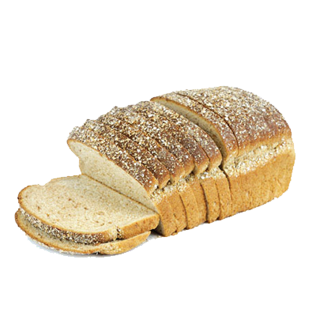
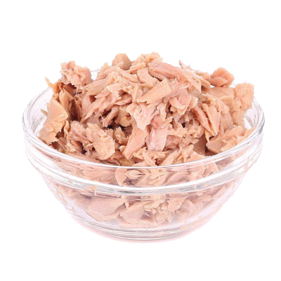
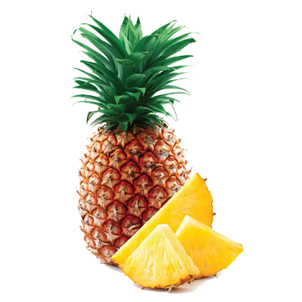

Slide 29
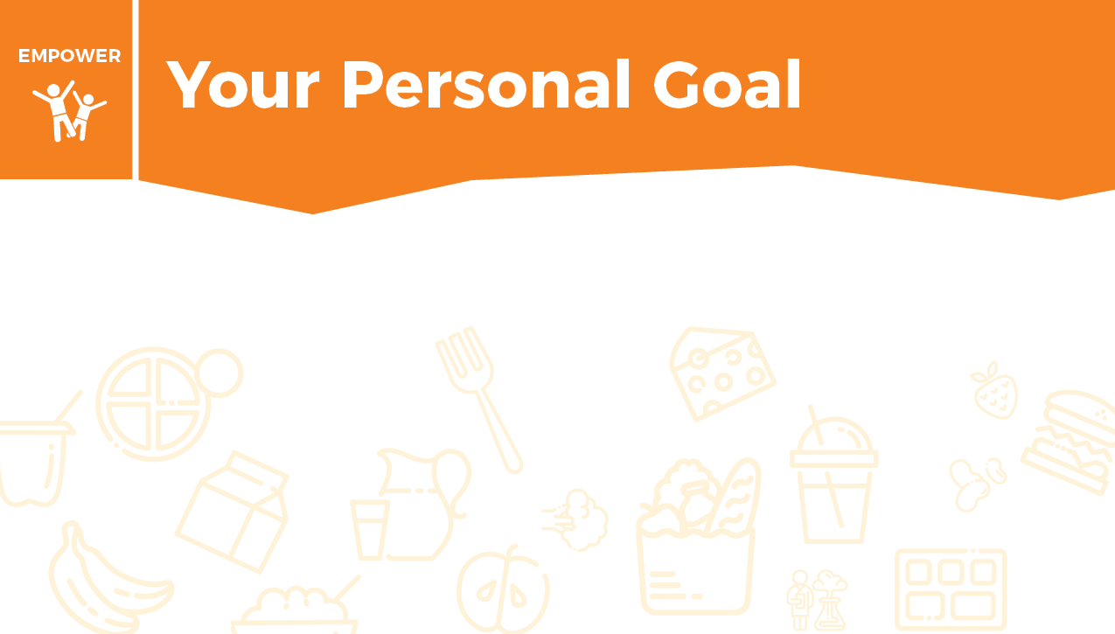
Think about a goal that you can create for yourself that is connected with trying new foods. You can use this sentence frame, “When we shop for food or when I eat my next meal, I will choose to try _______________________ as a new food.”

Slide 30

Supermarket Sweep
Take a piece of paper and list the 5 food groups (Dairy, Vegetables, Fruits, Grains, Protein). You can play alone or with a family member. Each player has 30 seconds to go find an item from a food group. Once you have items in each category, think of how you can create a meal using items from all the food groups.
Example:
You have 30 seconds to go find a food item and place it in the correct food group. You can bring back milk for the Dairy group. Next, you have 30 seconds to go find another item in 1 of the 4 remaining food groups. You can bring back bread for the Grains group. This continues until all 5 food groups are completed.

Slide 31
Household Item Sweep
You can also play with household items. Each food group helps the body. (Dairy builds strong teeth and bones; Vegetables help the skin and eyes; Fruits help the body heal; Grains give energy; Protein builds strong muscles.) You have 1 minute to go find a household item that does what each food group does for the body.
Example:
Toothpaste can represent Dairy since it helps with keeping your teeth strong. Glasses can represent the Vegetables group because vegetables help your eyes. Bandages can represent Fruits because fruits help you heal. Batteries can represent the Grains group because grains give you energy. A weight or heavy book can represent Protein because lifting heavy things can help build muscles.

Slide 32


Slide 33
Take this short Knowledge Check to share what you learned.

